Slide 1
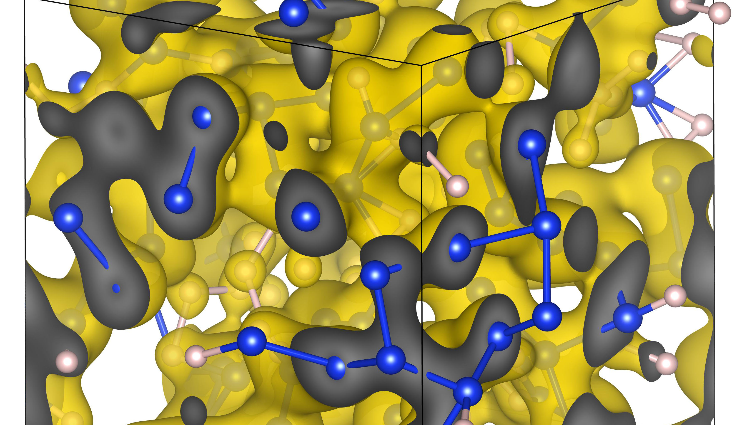
First-Principles Equation of State Database
For Warm Dense Matter Computations
Burkhard Militzer, F. Gonzalez, S. Zhang, K. Driver, F. Soubiran
UC Berkeley
UC Berkeley
LLE
LLNL
CEA

Slide 2
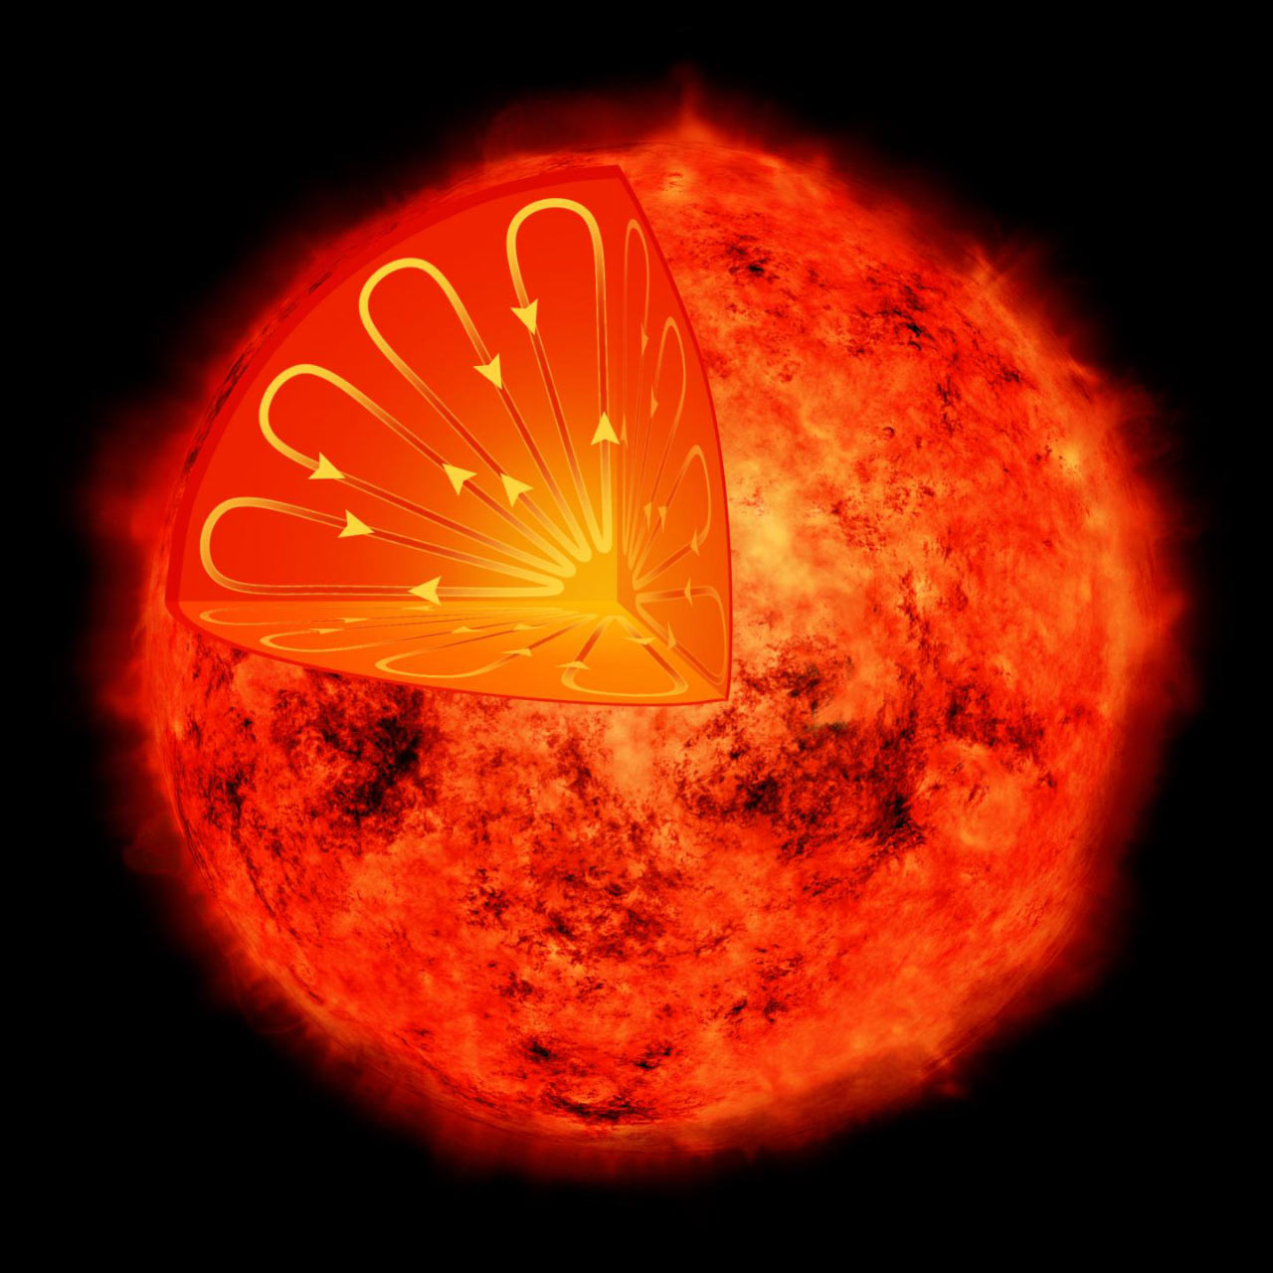
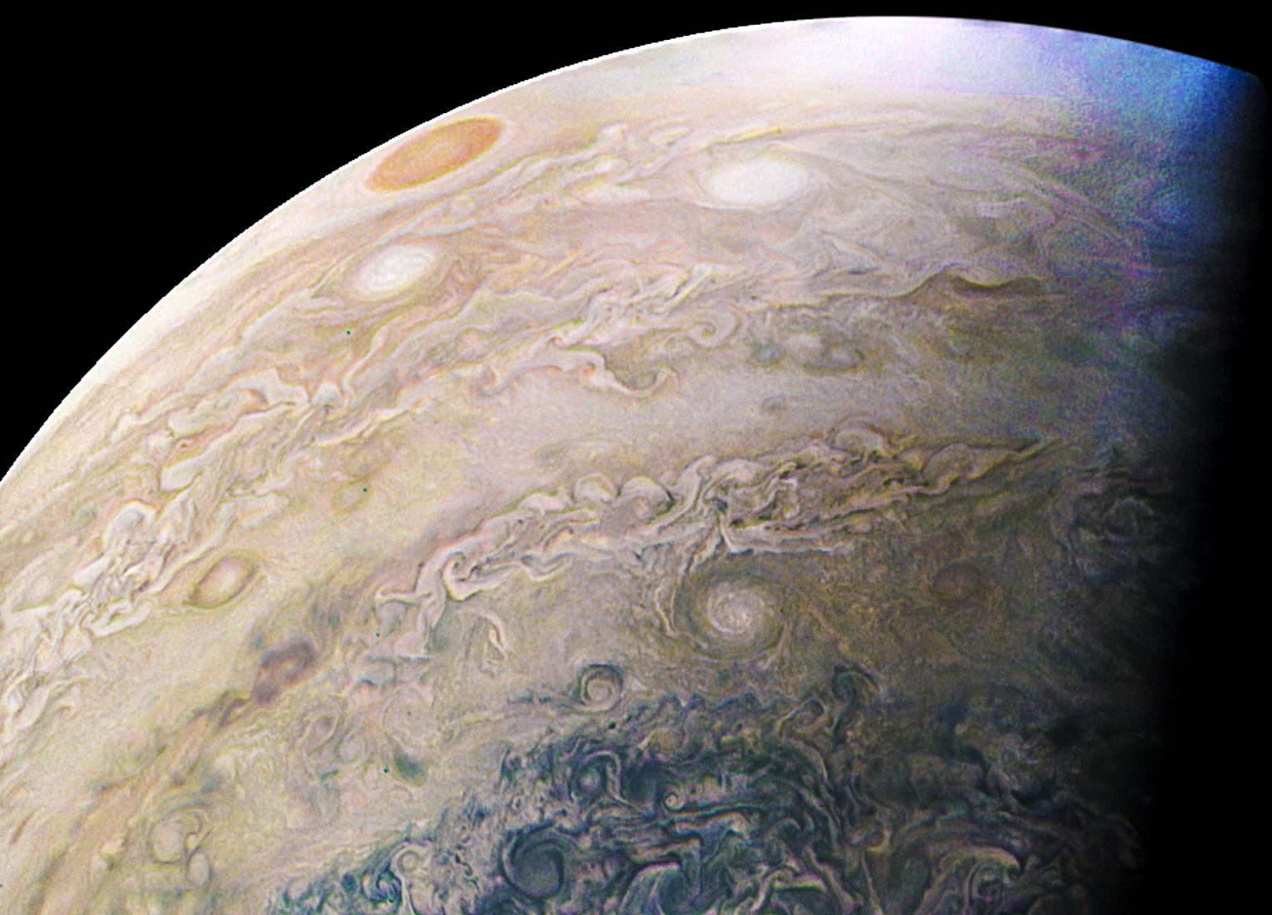
Center for Matter under Extreme Conditions (CMEC)

Slide 3
Outline
Path integral Monte Carlo (PIMC) method
Linear mixing approximation
FPEOS database
Comparison with different experiments

Slide 4
I.
Path Integral Monte Carlo

Slide 5
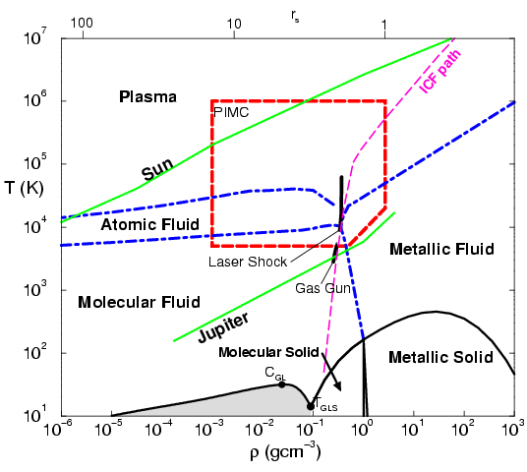
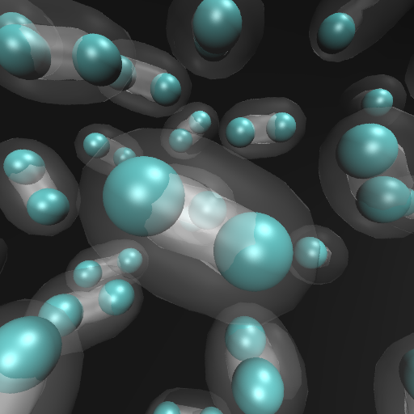
Density functional molecular dynamics at lower T
Temperature (K)
Born-Oppenheimer approx.
MD with classical nuclei:
F = m a
Forces derived DFT with
electrons in the instantaneous
ground state.

Slide 6
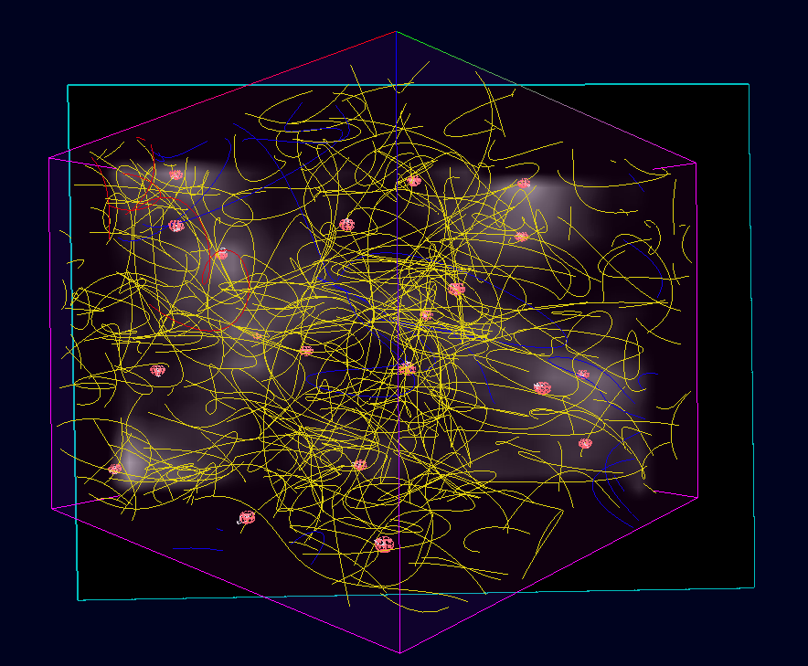
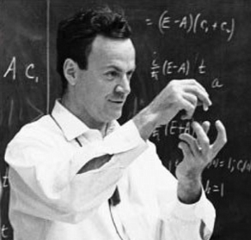
Path integral Monte Carlo at high T > 10⁴…10⁶ K
Temperature (K)
n=10¹⁸ cm⁻³
n=10²⁶ cm⁻³

Slide 7
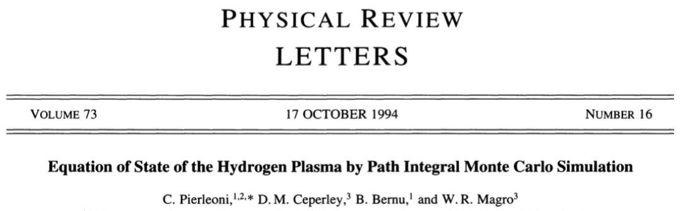
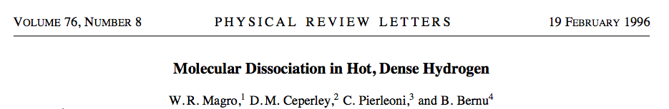
Starting from Restricted PIMC Simulations of Hydrogen

Slide 8
PIMC and DFT-MD Simulations of
Hydrogen and Helium
Hydrogen
Helium
S. X. Hu, B. Militzer, V. N. Goncharov, S. Skupsky, Phys. Rev. Lett., 104 (2010) 235003
Phys. Rev. B 84 (2011) 224109.
B. Militzer, Phys. Rev. B 79 (2009) 155105
B. Militzer, Phys. Rev. Lett. 97 (2006) 175501

Slide 9
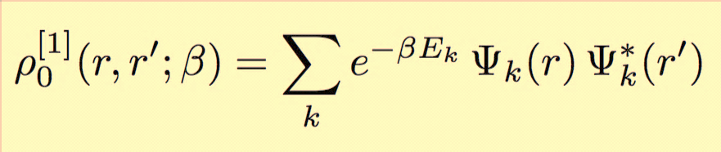
Restricted PIMC for fermions:
How is the restriction applied?
Construct a fermionic trial density matrix in form of a Slater determinant of single-particle density matrices:
Imaginary time
Enforce the following nodal condition
for all time slices along the paths:
This 3N-dimensional conditions eliminates all negative and some positive contribution to the path ➝ Solves the fermion sign problem approx.
x
Free-particle nodes:

Slide 10
Silicates:
MgSiO₃

Slide 11
MgSiO₃ : Principal Hugoniot Curve
Gonzalez, Soubiran, Peterson, Militzer,
Phys. Rev. B 101 (2020) 024107

Slide 12
MgSiO₃ : Principal Hugoniot Curve
Millot et al. (2019)

Slide 13
MgSiO₃ : Principal Hugoniot Curve
Gonzalez, Soubiran, Peterson, Militzer,
Phys. Rev. B 101 (2020) 024107

Slide 14
CH plastics

Slide 15
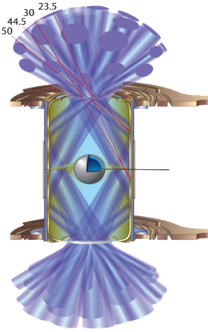
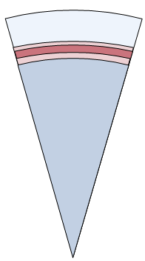
Inertial confinement fusion experiments with plastic coated spheres of liquid H₂
CH
H₂ (liquid)
(Graphics: Bachmann et al. LLNL)

Slide 16


PIMC and DFT-MD simulations performed for C₂H, CH, C₂H₃, CH₃ and CH₄.
All calculations performed on

Slide 17
CH Shock Hugoniot Curves:
Comparison of Theory and Experiments

Slide 18
CH Shock Hugoniot Curves:
Comparison of Theory and Experiments
S. Zhang, Phys. Rev. E, 96 (2017) 013204

Slide 19
CH Shock Hugoniot Curves:
Comparison of Theory and Experiments

Slide 20
CH Shock Hugoniot Curves:
Comparison of Theory and Experiments

Slide 21
Linear Mixing and
FPEOS database

Slide 22
Hugoniot Curves of BN and B₄C
Fully interacting EOS and Linear Mixing agree quite well.
Boron nitride
Zhang et al. PRB 2019
Boron carbide
Zhang et al. PRE 2020

Slide 23
Hugoniot Curves of BN and B₄C
Fully interacting EOS and Linear Mixing agree quite well.
Boron nitride
Zhang et al. PRB 2019
Boron carbide
Zhang et al. PRE 2020

Slide 24
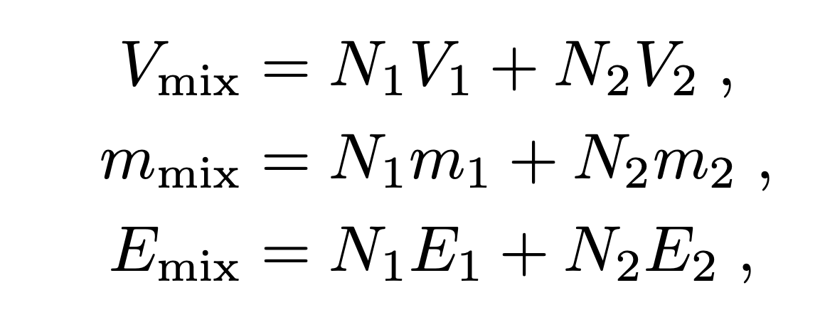
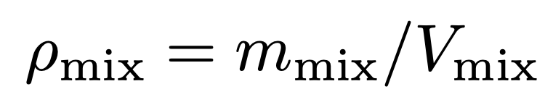

Linear Mixing at Constant P and T
(Also called additive volume rule)
$$≈$$
Compound MgO
Mg O

Slide 25
Hugoniot Curves of MgO and MgSiO₃
Results from fully interacting EOS and experiment.
Soubiran et al. JCP 2019
Gonzalez et al. PRB 2020
McCoy et al.
PRB 2019
Millot et al.
GRL 2020

Slide 26
Hugoniot Curves of MgO and MgSiO₃
Fully interacting EOS and Linear Mixing agree quite well.
Soubiran et al. JCP 2019
Gonzalez et al. PRB 2020
McCoy et al.
PRB 2019
Millot et al.
GRL 2020
Linear mixing works well for $T≳2×{10}^{5}K \text{and} {ρ/ρ}_{0}≳$ 3.2

Slide 27

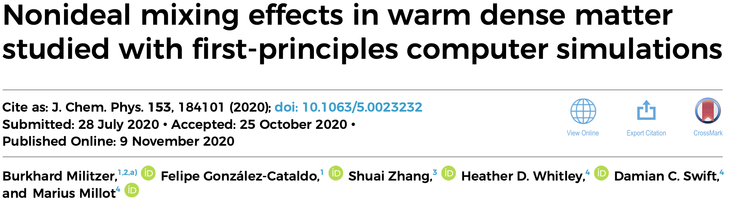
Hugoniot Curves of BN and B₄C

Slide 28
Nonlinear Mixing Effects in MgSiO₃
Fully interacting EOS and Linear Mixing agree quite well.
Linear mixing works well for $T≳2×{10}^{5}K \text{and} {ρ/ρ}_{0}≳$ 3.2

Slide 29
Hugoniot Curves of CO and CO₂
Experimental CO₂ Hugoniot agree with Linear Mixing result
Crandall et al.
PRL 2020

Slide 30
Hugoniot Curves of H₂O, H₂O₂, and Al₂O₃
Experimental H₂O Hugoniot agree with Linear Mixing result
Reanalyzed by
Knudson et al.
Experiments by
Podurets et al. 1972

Slide 31
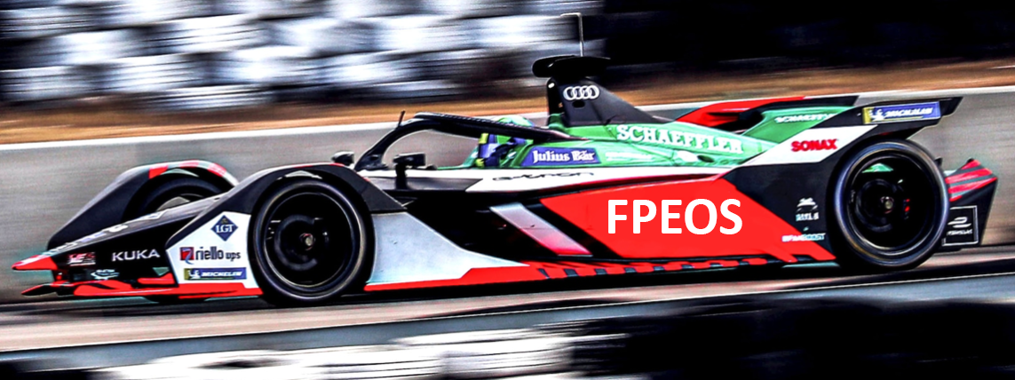
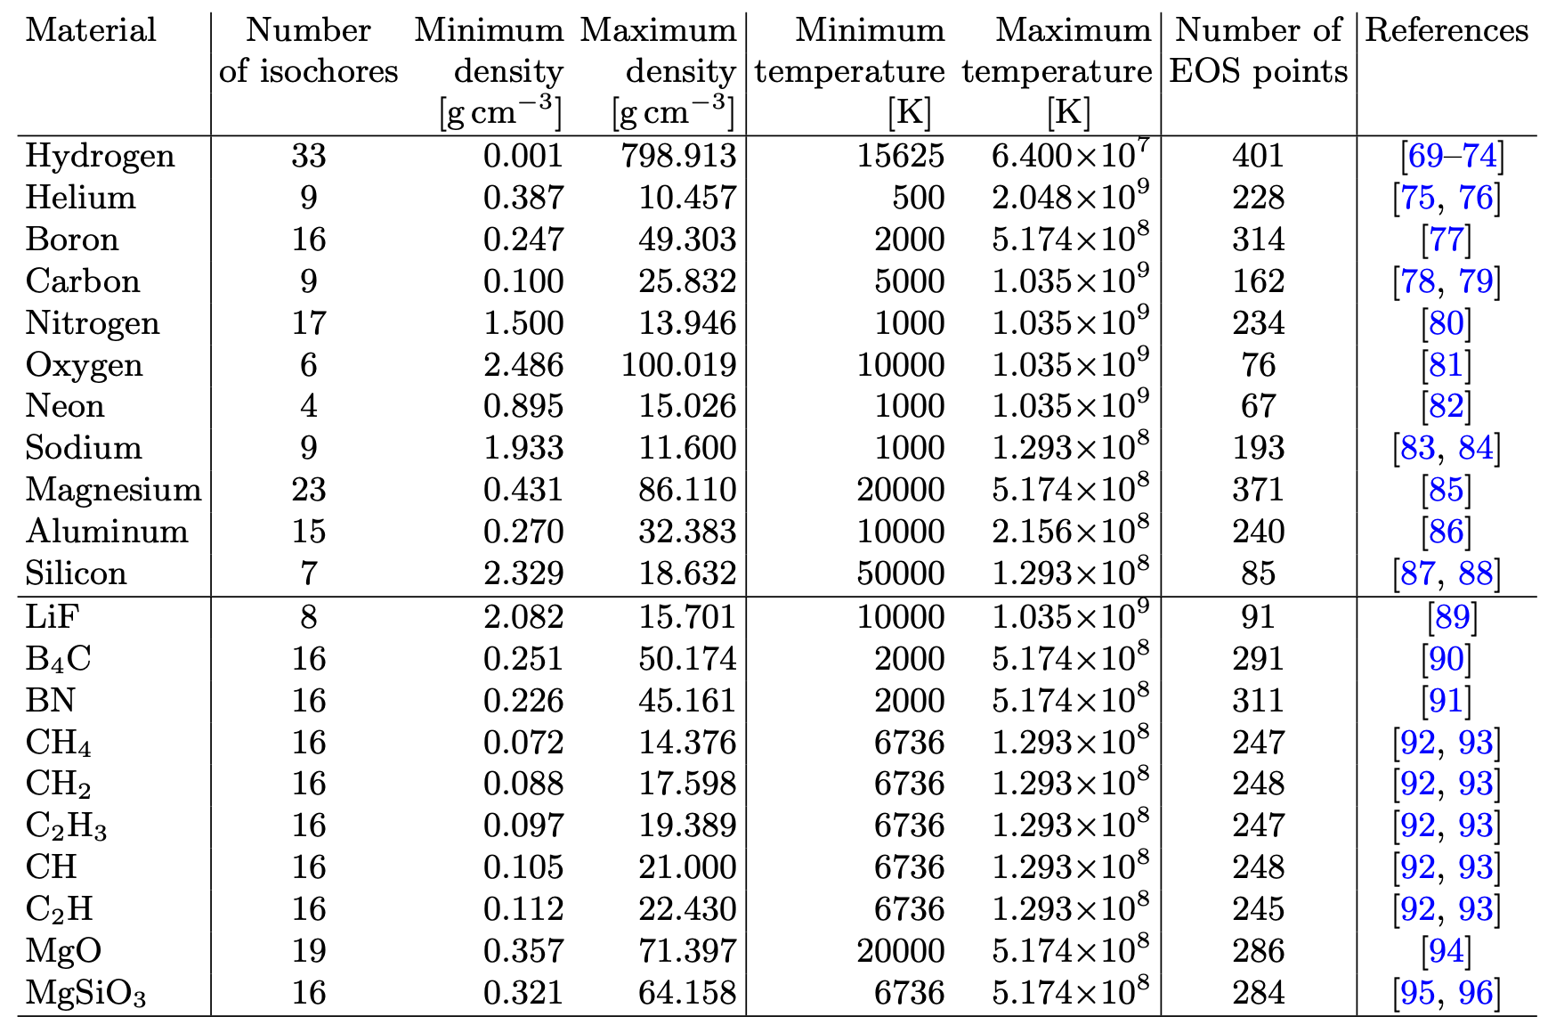
FPEOS: 11+10 Available Tables

Slide 32
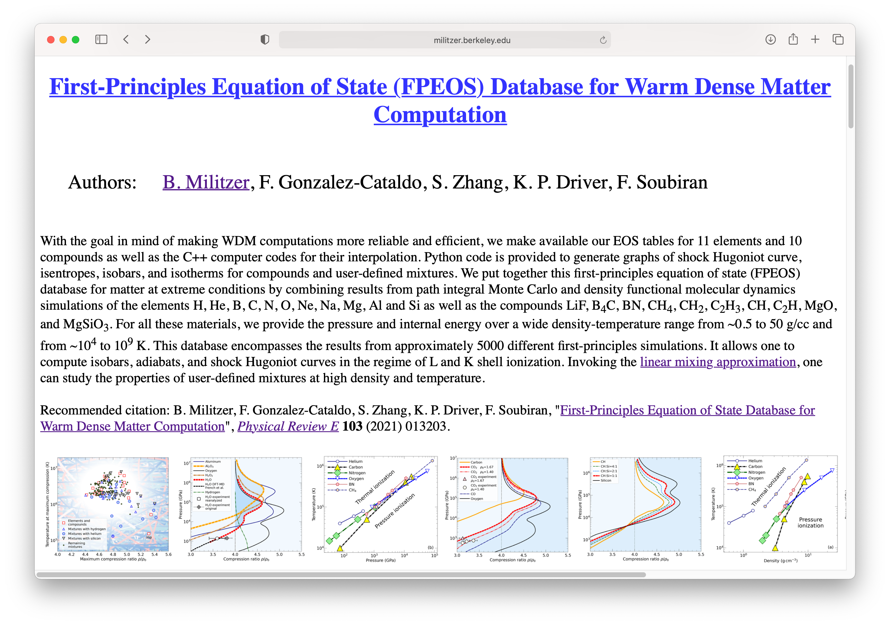
First-Principles Equation of State Database online http://militzer.berkeley.edu/FPEOS
5000 first-principles calculations have been combined into our FPEOS database. So anyone can predict shock Hugoniot curves for a variety of compounds and mixtures. This will make warm dense matter calculations more reliable and efficient.

Slide 33
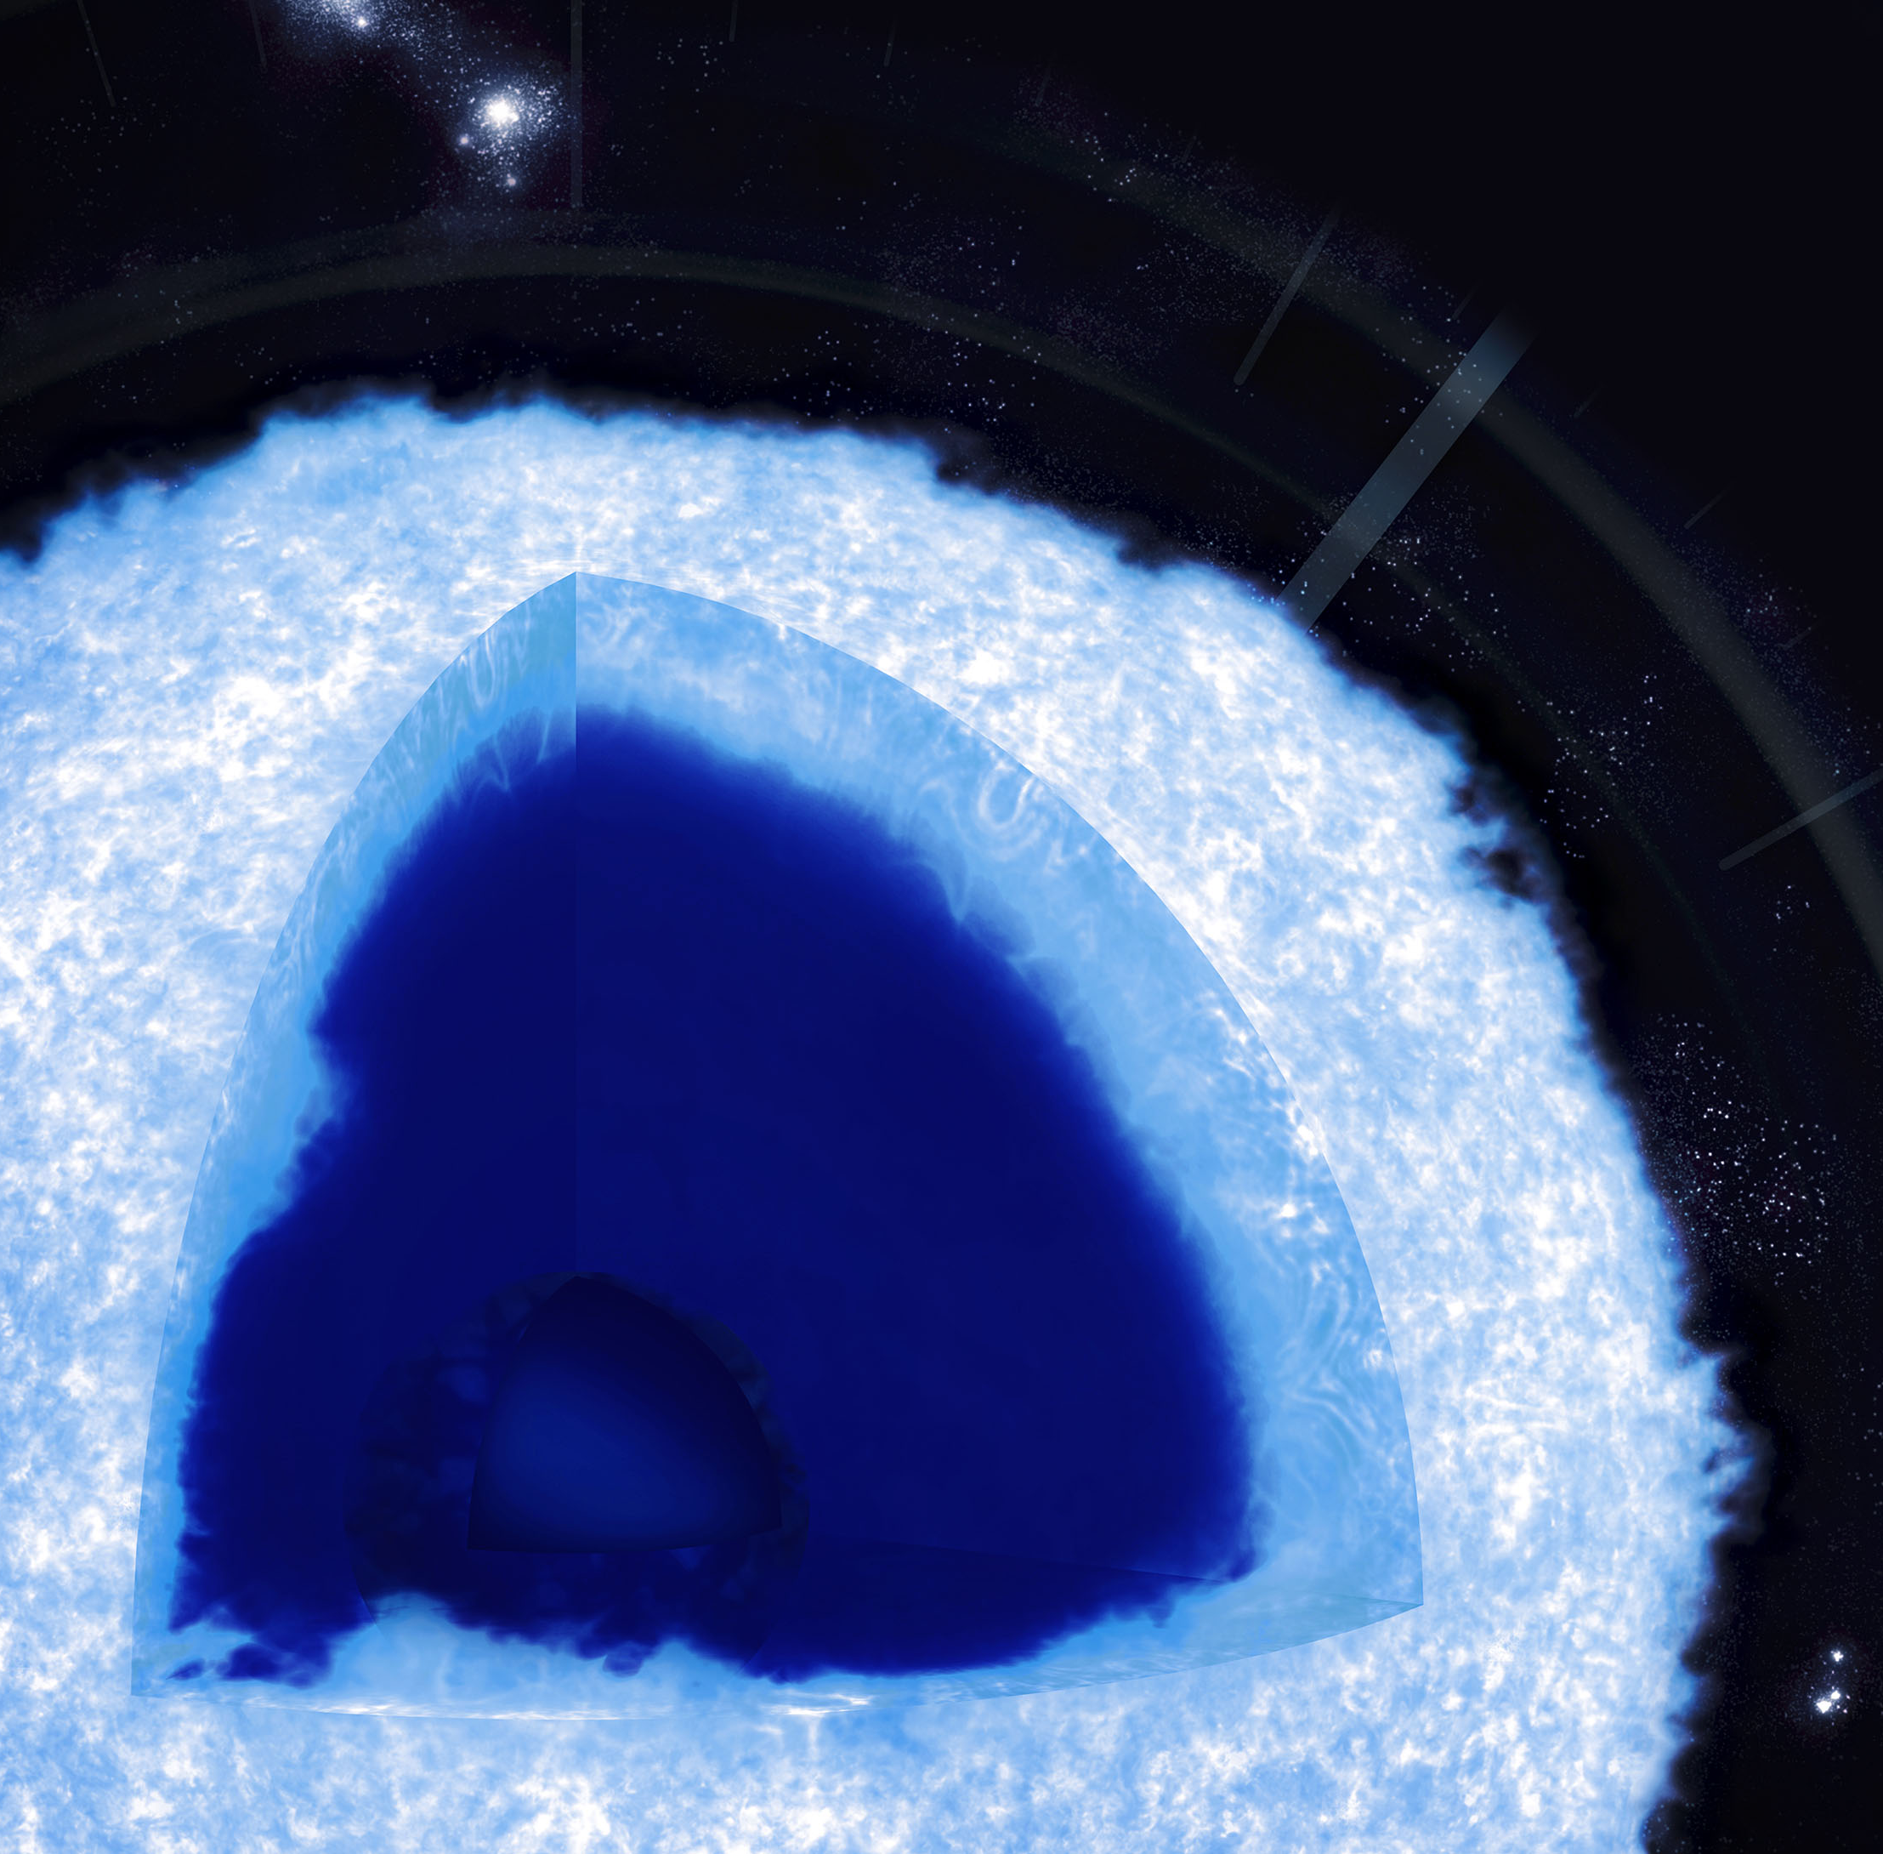
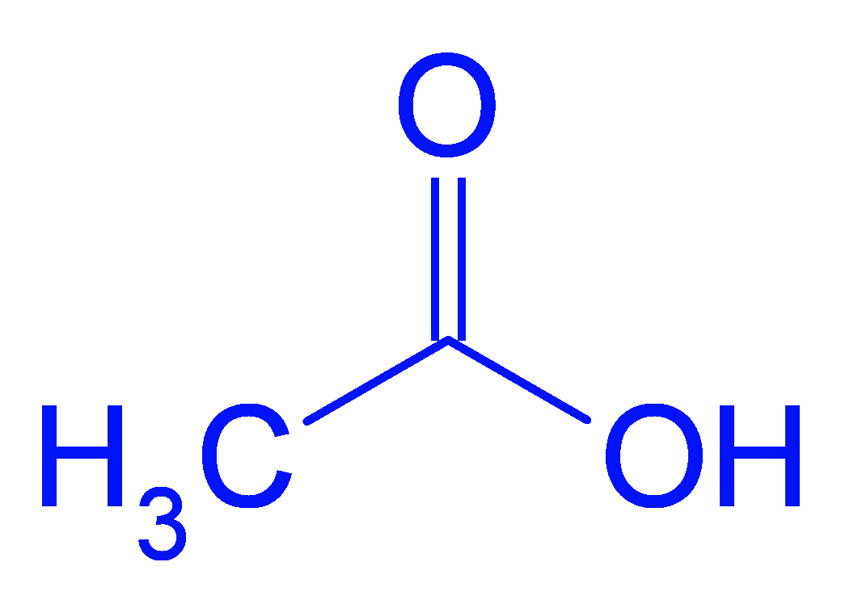
NIF Gbar Experiment: Equations of State of C-O Mixtures in White Dwarf Stars
PI: D. Saumon (LANL), Blouin, Glenzer, Swift, Kritcher, Doppner, Whitley, Lazicki, Falcone, Militzer
We propose to make EOS measurements along the Hugoniot with the Gbar platform of carbon-oxygen rich materials that resemble conditions in White Dwarf stars.
SLAC graphics
Acetic acid
C₂O₂H₄
Glyoxal
C₂O₂H₂
Graph made by D. Saumon
comp:~/fpeos> fpeos binaryMixture EOS1=6 2.0 EOS2=18 2.0 rho0=1.27 E0=-227.8
comp:~/fpeos> fpeos binaryMixture EOS1=6 2.0 EOS2=16 2.0 rho0=1.049 E0=-229.0
Glyoxal C₂O₂H₂
Acetic acid C₂O₂H₄

Slide 34
FPEOS
demo

