Slide 1
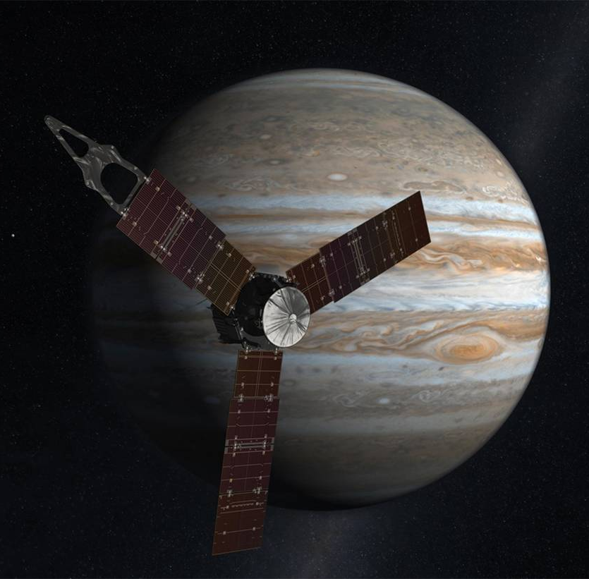
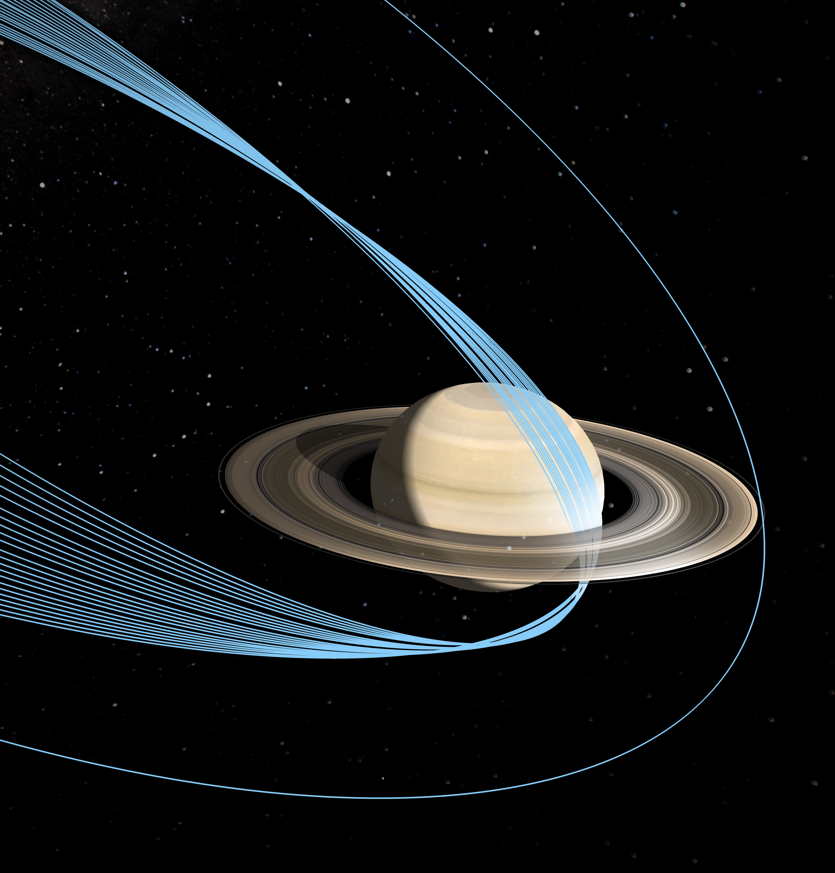
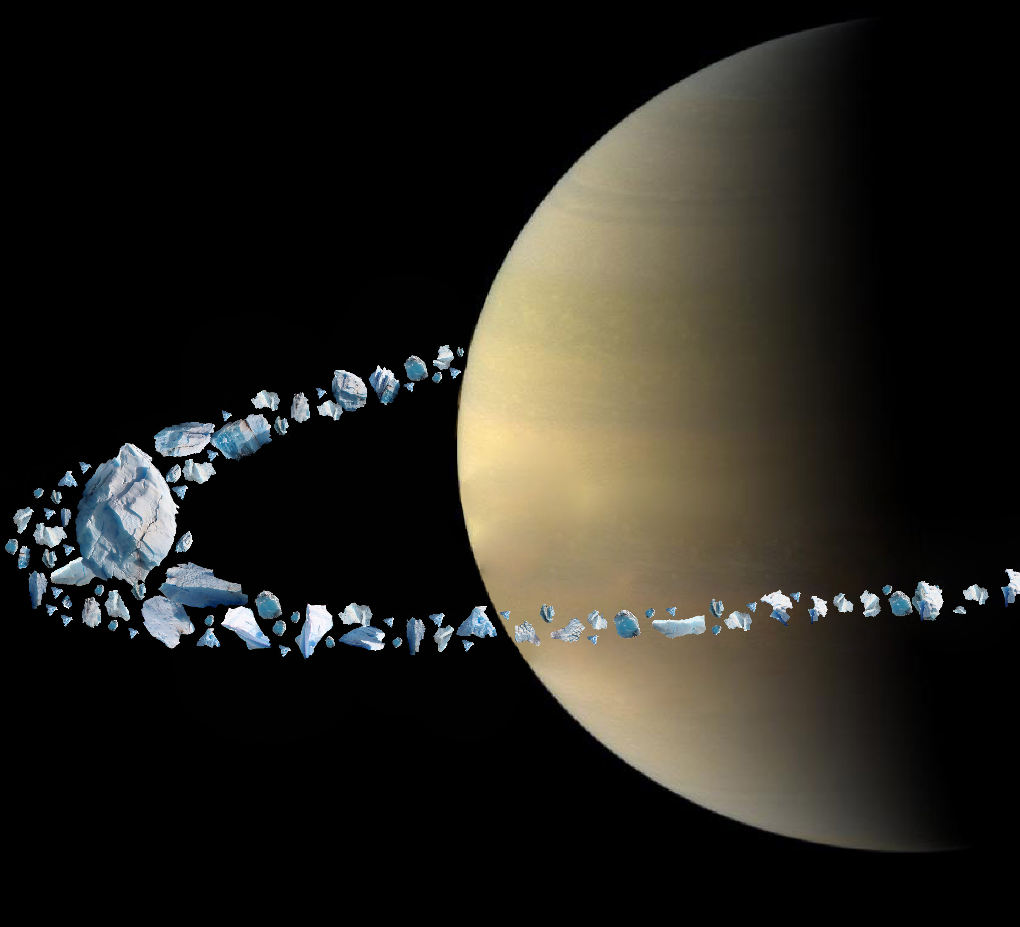
Quadratic Monte Carlo to Understand Jupiter’s Interior Structure and the Origin of Saturn’s Ring
B. Militzer, W. B. Hubbard, J. Wisdom, R. Dbouk,
F. Nimmo, B. Downey, R. French
UC Berkeley
U Arizona
MIT
MIT
UCSC
UCSC
Wellesley

Slide 2
Big Questions that my Group Helps Address
How did our solar system form?
What are giant planets made of?
How do material behave at high pressure?

Slide 3
Outline
Juno mission and Jupiter’s Dilute Core
How did Saturn become the Lord of the Rings?
Quadratic Monte Carlo – a general- purpose sampling method

Slide 4
1. Juno Mission and Dilute Core

Slide 5
2. How did Saturn become the Lord of the Rings?

Slide 6
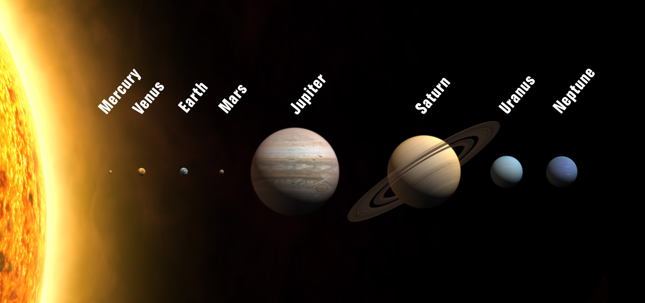
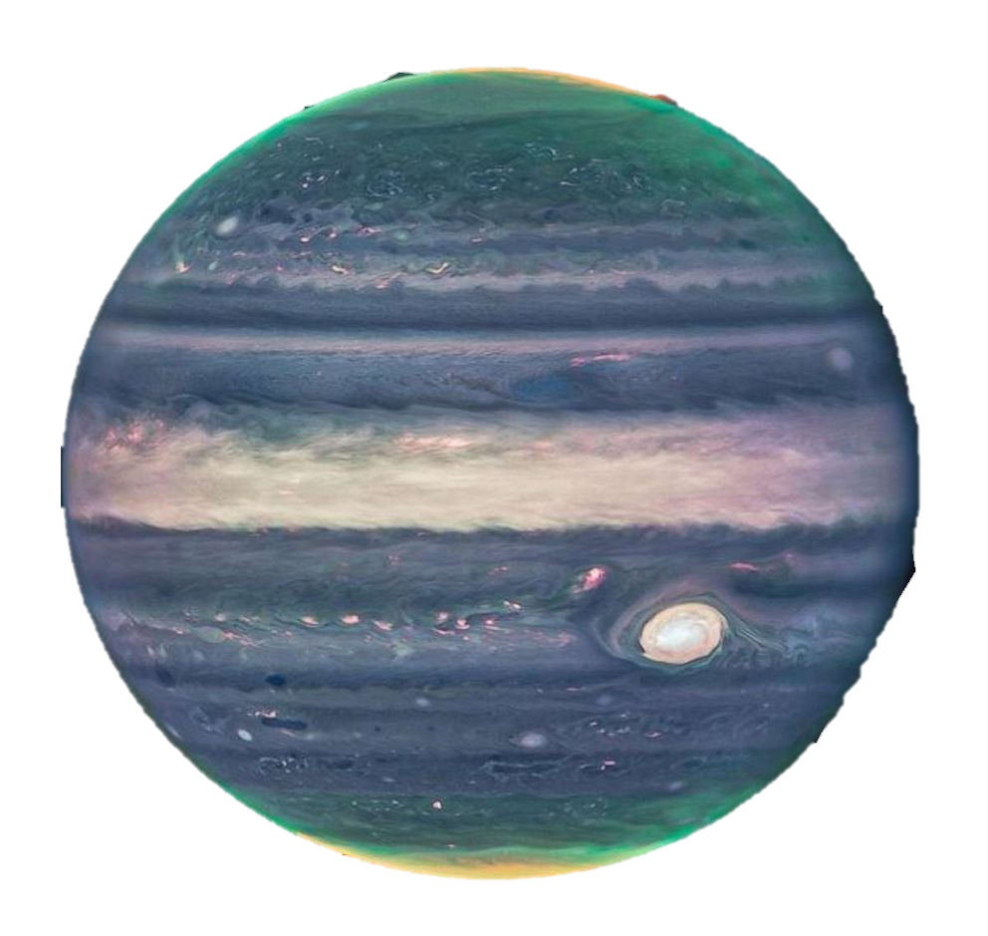
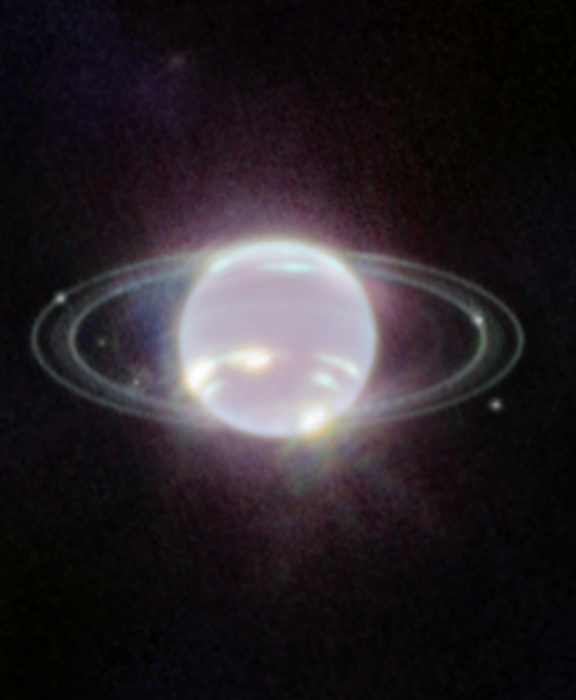
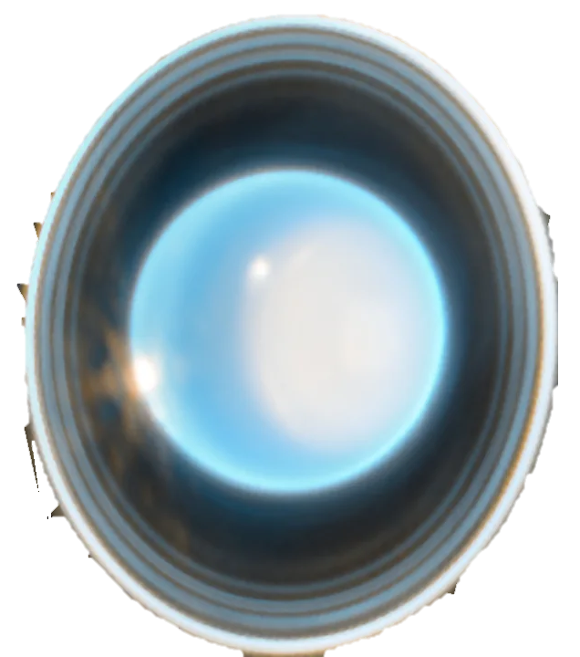
What is so Unusual About Planet Saturn?

Slide 7
3. Quadratic Monte Carlo Method

Slide 8
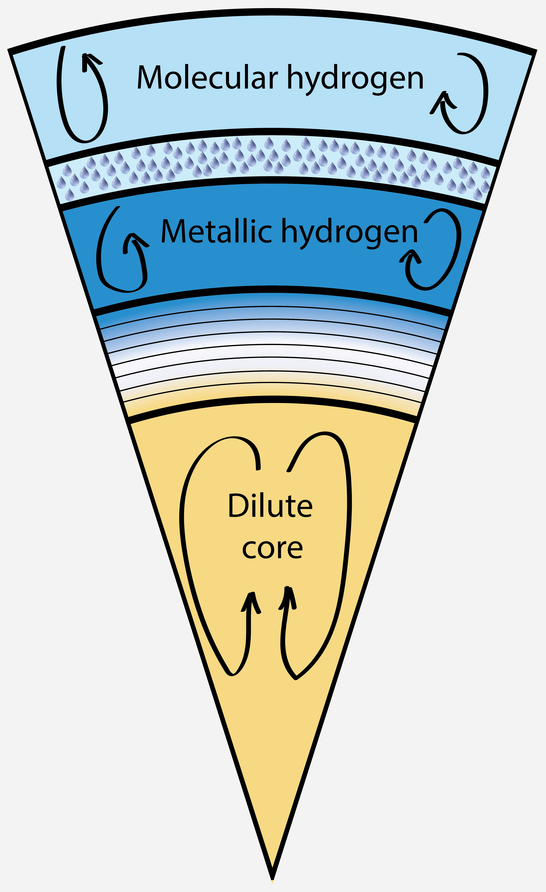
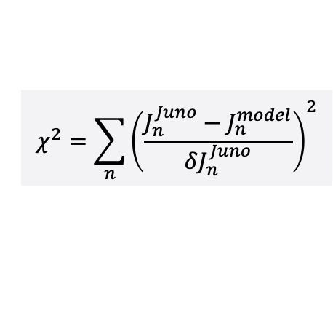

Apply our QMC method Dilute Core Models
M_{env}
M_{trans}
Z₂
M_{core}
M_{core}
Probability$\sim exp⁡\left\{−χ^{2}/2\right\}$
$$χ^{2}=\sum_{n}{{\left(\frac{J_{n}^{Juno}−J_{n}^{model}}{δJ_{n}^{Juno}}\right)}^{2}}$$
M_{env}
M_{trans}

Slide 9
Apply our QMC method Dilute Core Models
M_{env}
M_{trans}
M_{env}
M_{core}
M_{trans}
M_{Z}
M_{core}
Z₂
Z₂
M_{Z}
M_{core}
M_{trans}
M_{env}

Slide 10
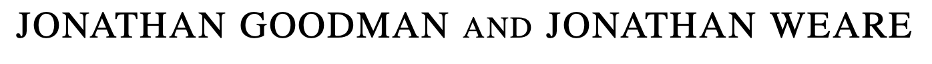
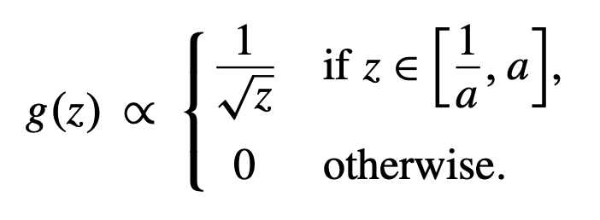


Affine Invariance MCMC by Goodman & Weare
$${\vec{r}}_{mover}$$
$${\vec{r}}_{guide}$$
Affine Stretch move
Ensemble of walkers employed to collect information about fitness landscape.

Slide 11
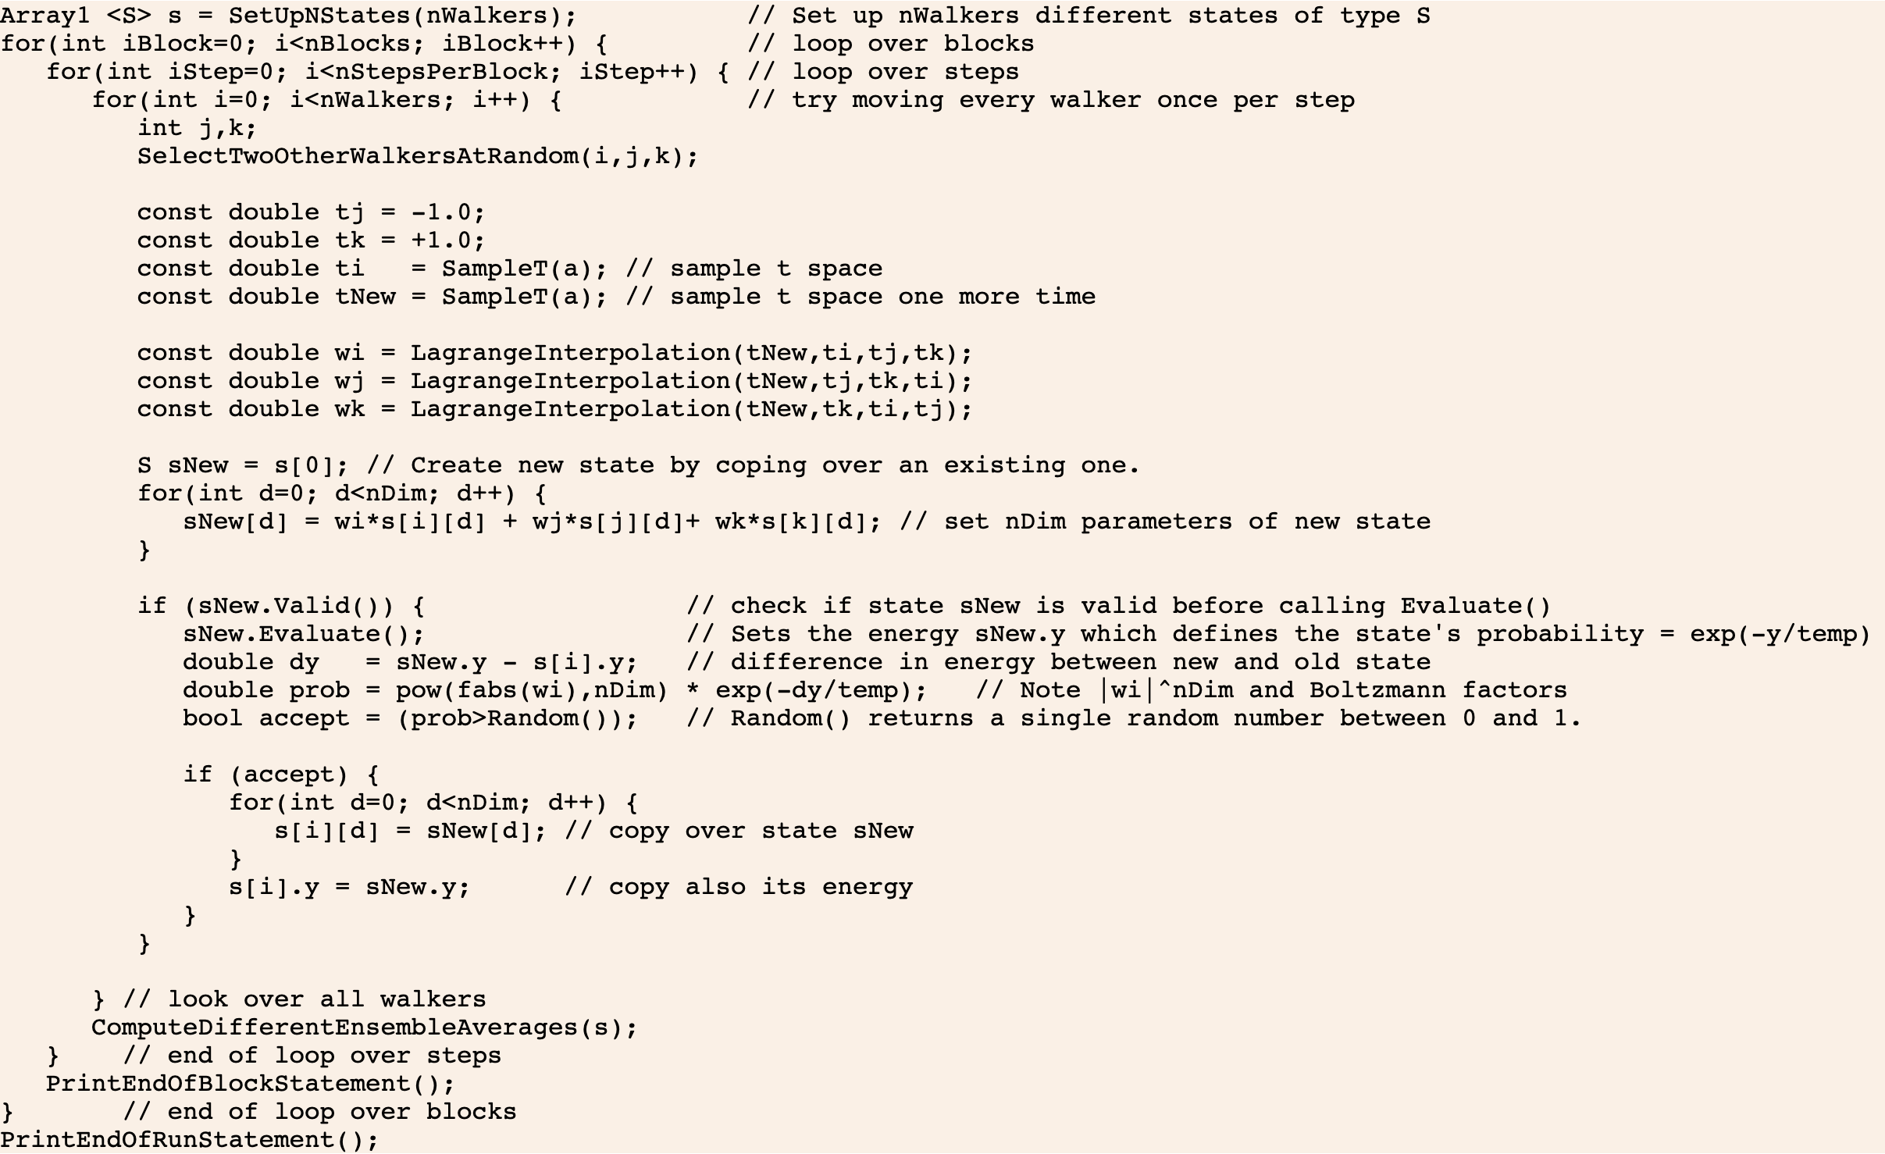
Our Quadratic Monte Carlo Method Explained at http://militzer.berkeley.edu/QMC
New lines
Prefactor requires discussion

Slide 12

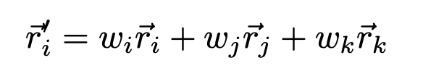
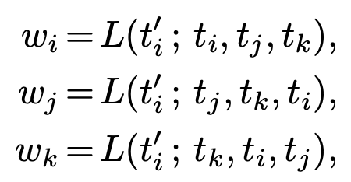
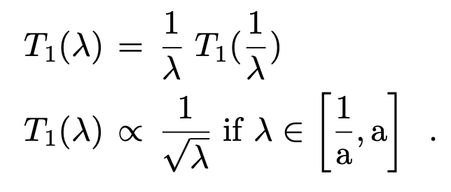
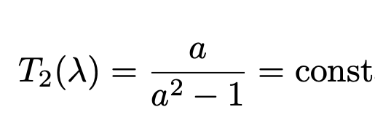
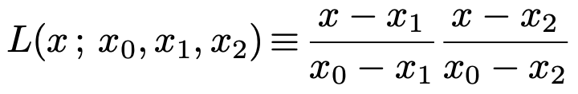


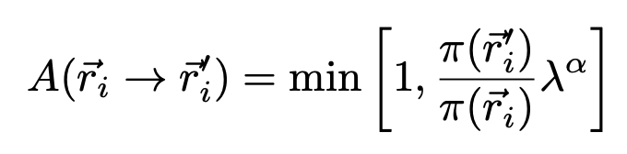
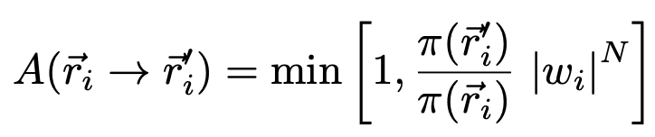
Sampling Details and Prefactors
Affine moves, type 1
Affine moves, type 2
Quadratic moves
BM, Astrophys. J. 953 (2023) 111

Slide 13
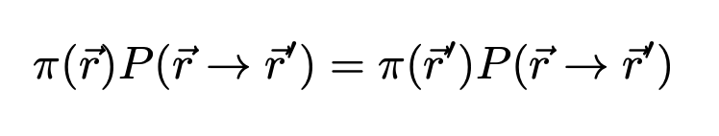
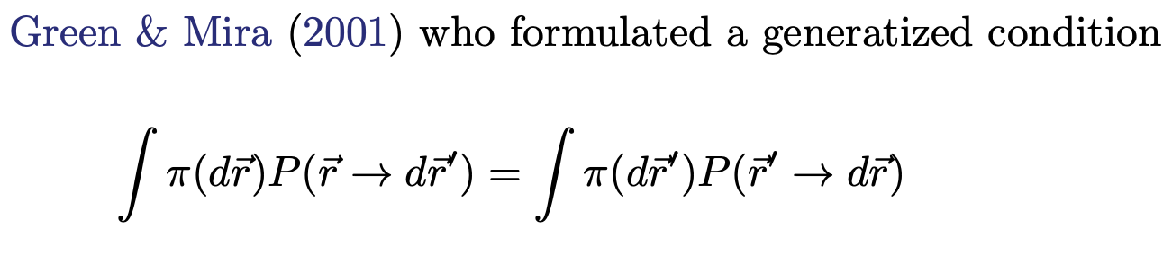
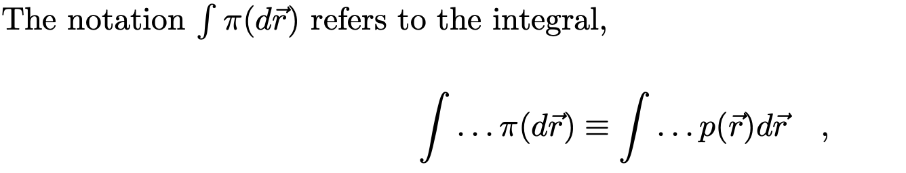
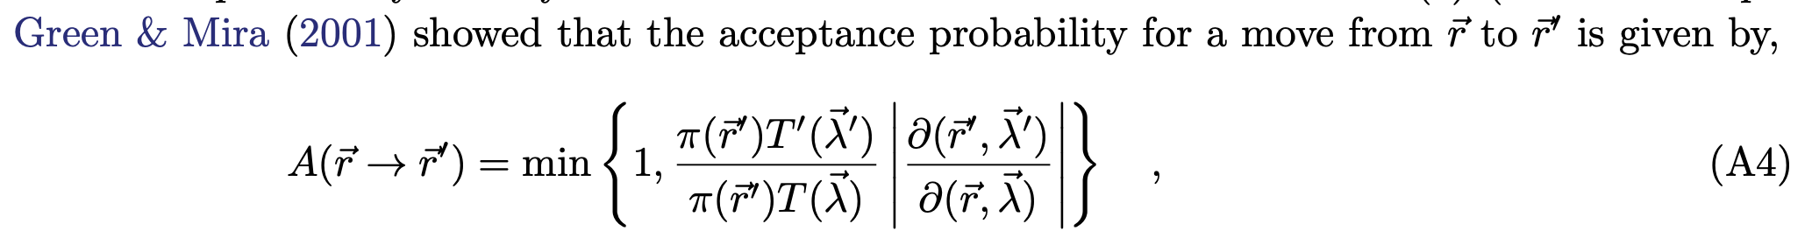
In Our Derivation of Prefactors, we follow Green and Mira
Regular detailed balance between two states

Slide 14
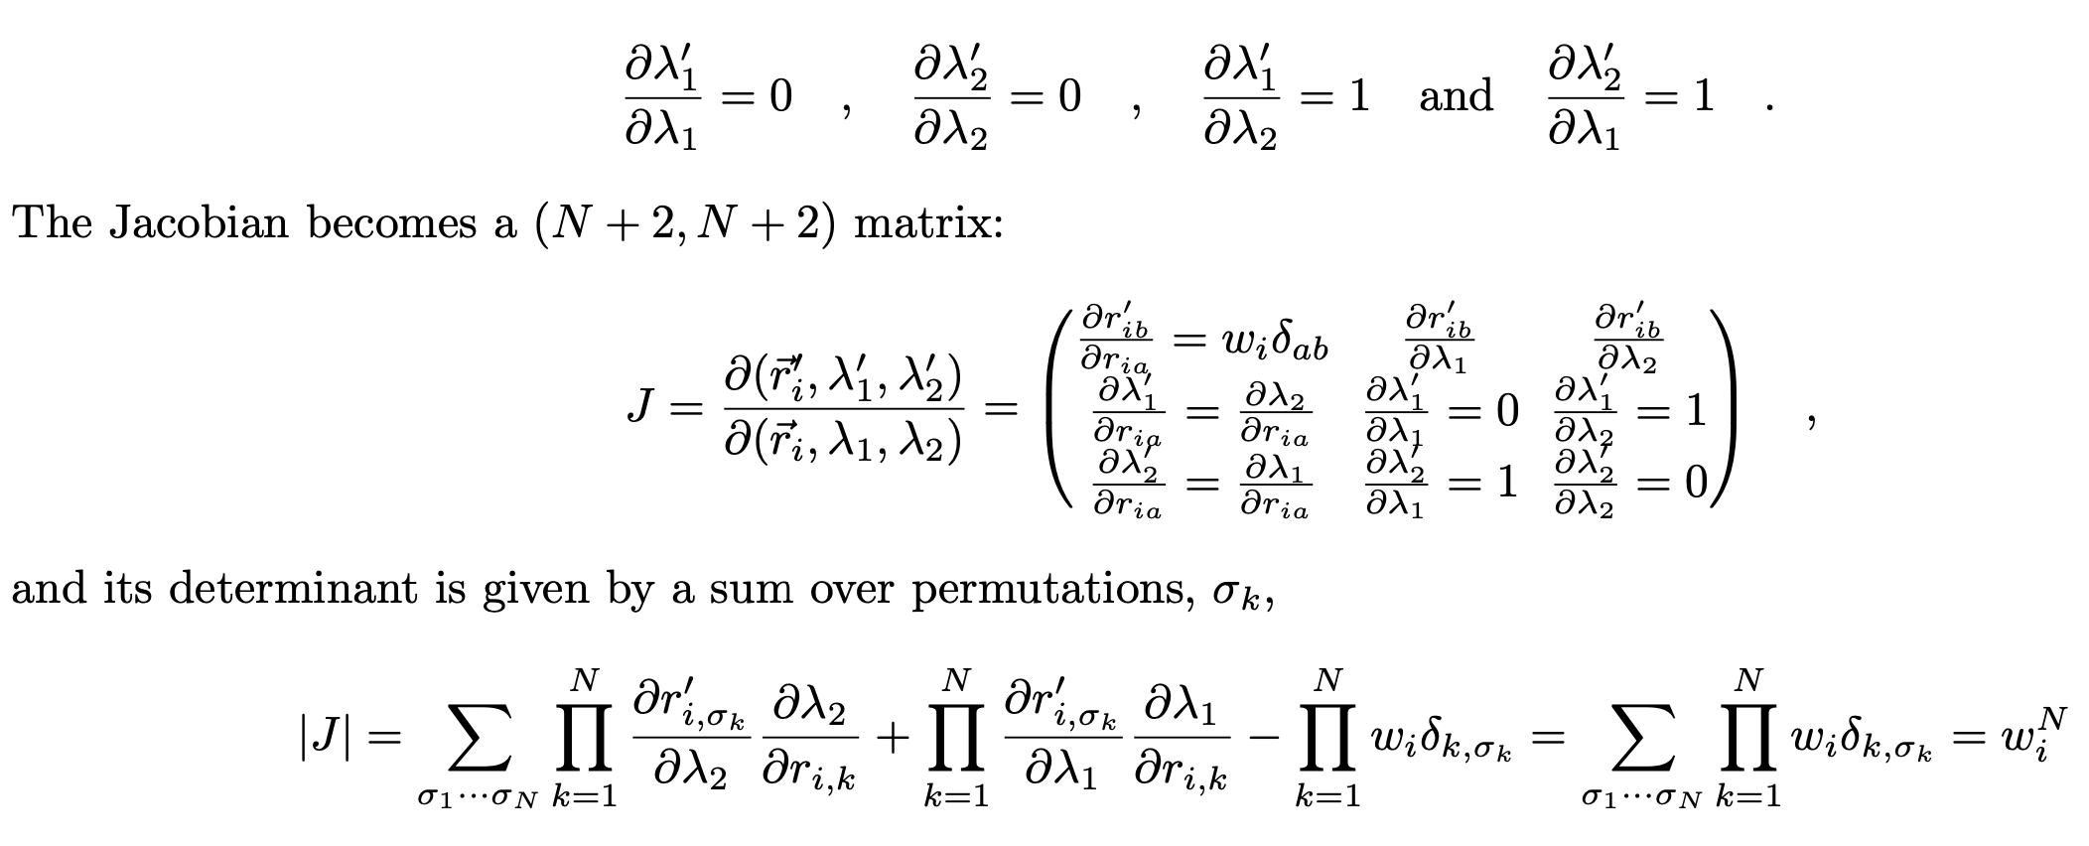
In Our Derivation of Prefactors, we follow Green and Mira

Slide 15
Our Quadratic Monte Carlo is more Efficient Than The Affine Invariant Sampler (emcee) that Moves Linearly
QMC is faster
B. Militzer,
Astrophysical J. 953 (2023) 111
Open QMC source code
10.5281/zenodo.8038144

Slide 16
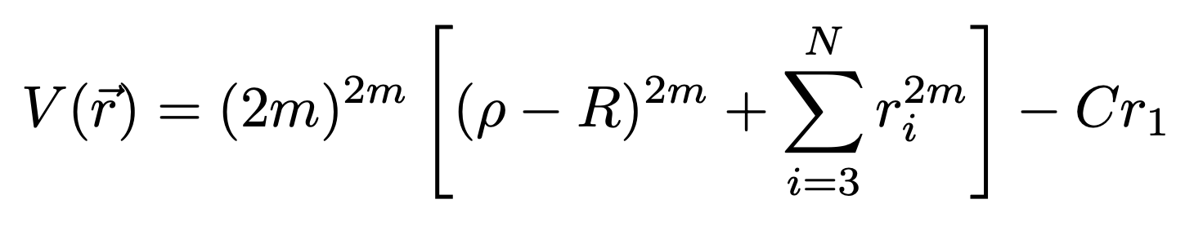
Our Test Case: A Ring Potential
Test case: Ring potential

Slide 17
Two Performance Criteria: Autocorrelation & Travel Time
QMC is faster
Quadratic moves yield smaller error bars and shorter travel times.
But don’t use too many walkers.
We suggest N_{W}=2D…3D

Slide 18
Comparison: QMC vs Affine Invariant Method
QMC moves are about four times as efficient
For tests in higher dimension, see: BM,
Astrophys. J
953 (2023) 111
Test case:
Ring potential in
18 dimensions

Slide 19
Comparison: QMC vs Affine Invariance Method
Test case:
Ring potential in
18 dimensions

Slide 20
Our Modified Walk moves
Modified “walk” moves also perform very well.
Test case:
Ring potential in
18 dimensions

Slide 21
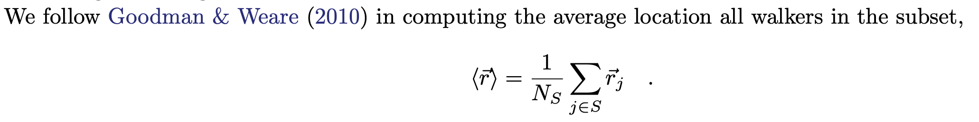
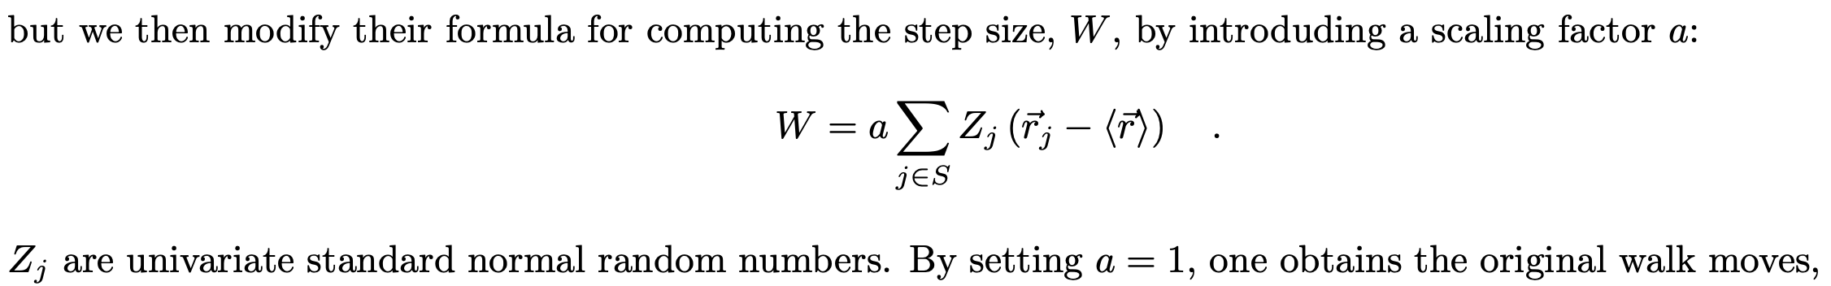
Our Modified Walk moves: Just Add a Scaling Factor
Modified “walk” moves also perform very well.

Slide 22
Apply our QMC method Dilute Core Models
Dilute core model T_{1bar}=166.1 K but EOS change by -3%
Dilute core model T_{1bar}=170 K
Our five-layer refence model with a dilute core T_{1bar}=166.1 K

Slide 23
Apply our QMC method Dilute Core Models

Slide 24
Apply our QMC method Dilute Core Models

Slide 25
Apply our QMC method Dilute Core Models

Slide 26
Apply our QMC method Dilute Core Models

Slide 27
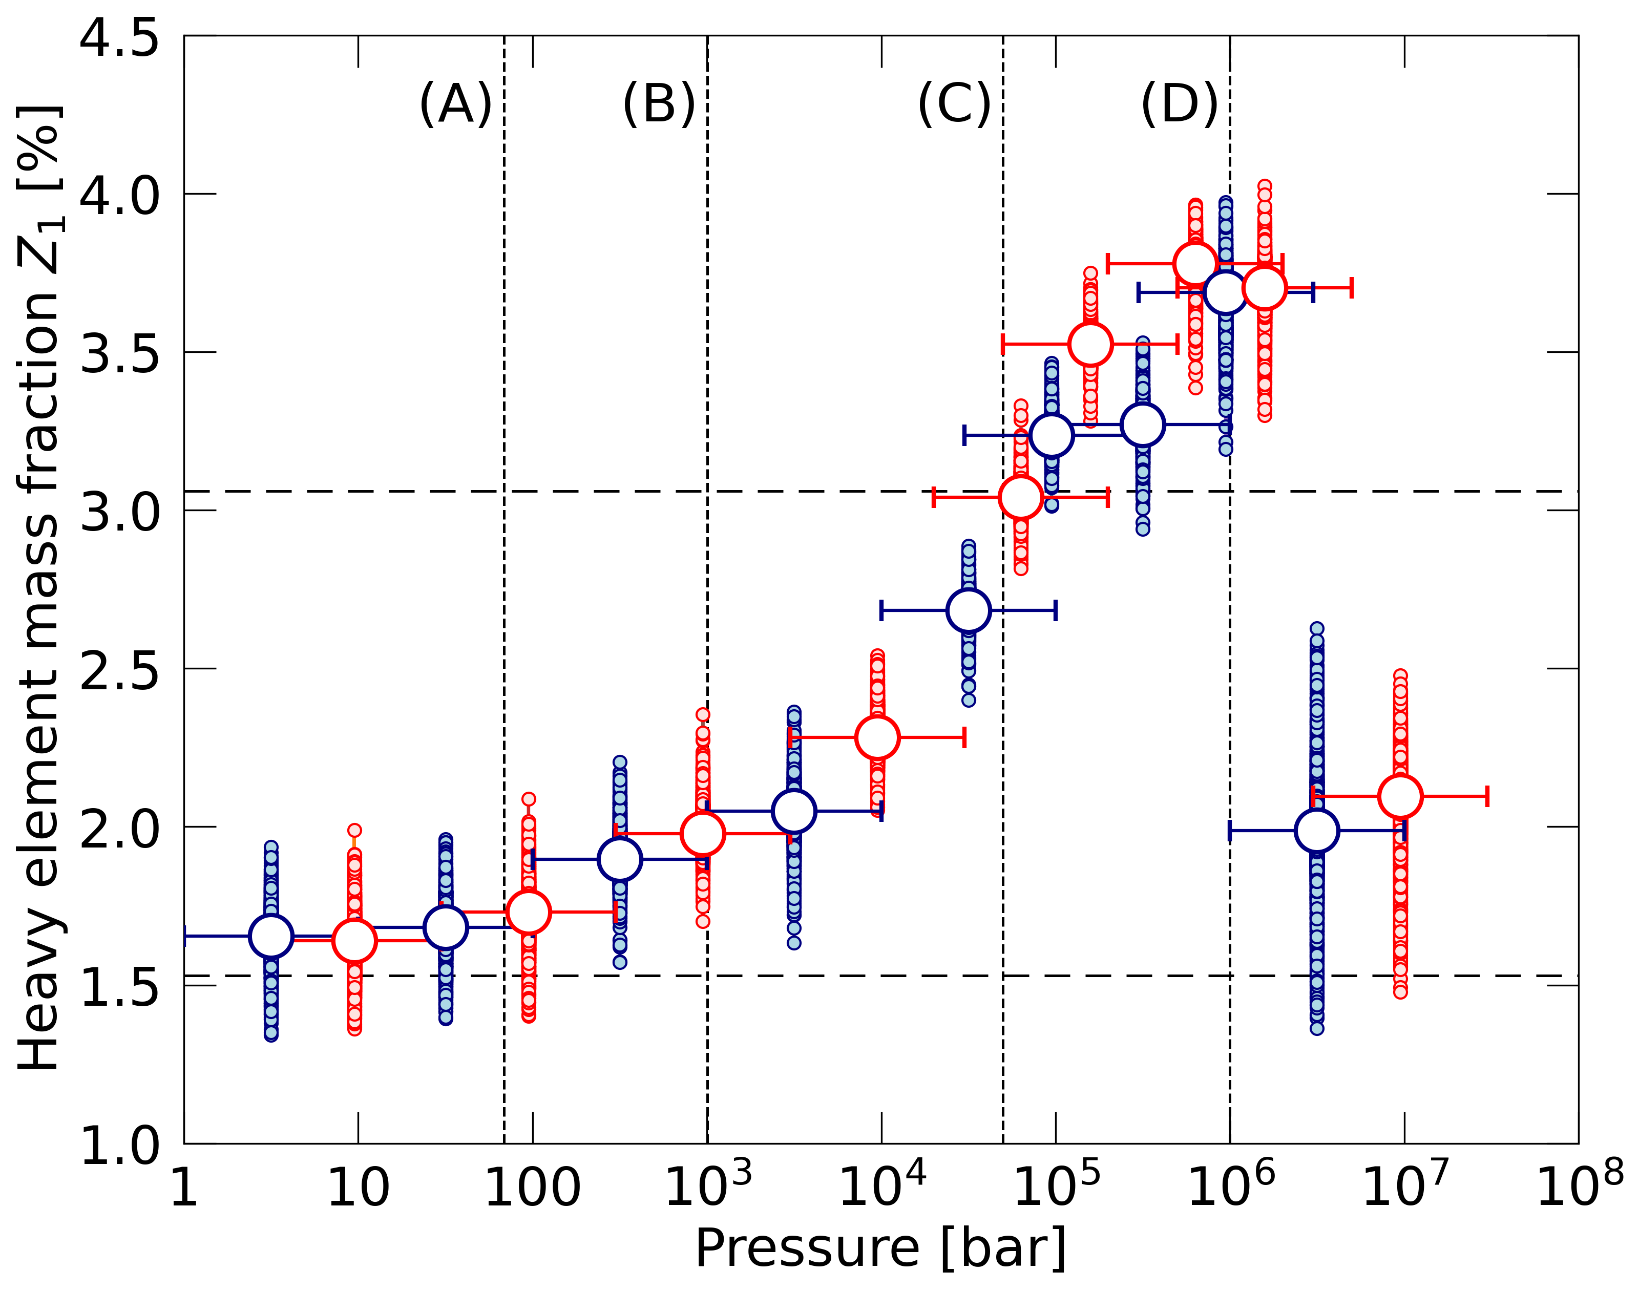
How does a 3% density reduction change Z₁?
In which pressure region are the models most sensitive?
Only from 10-100 GPa = 0.1-1 Mbar. Not the multi-megabar regime.
A 3% reduction over a “decade” of pressure approximately doubles Z₁ (given the typical assumptions inn our dilute core models.)
Paper accepted for publication in ApJ

Slide 28
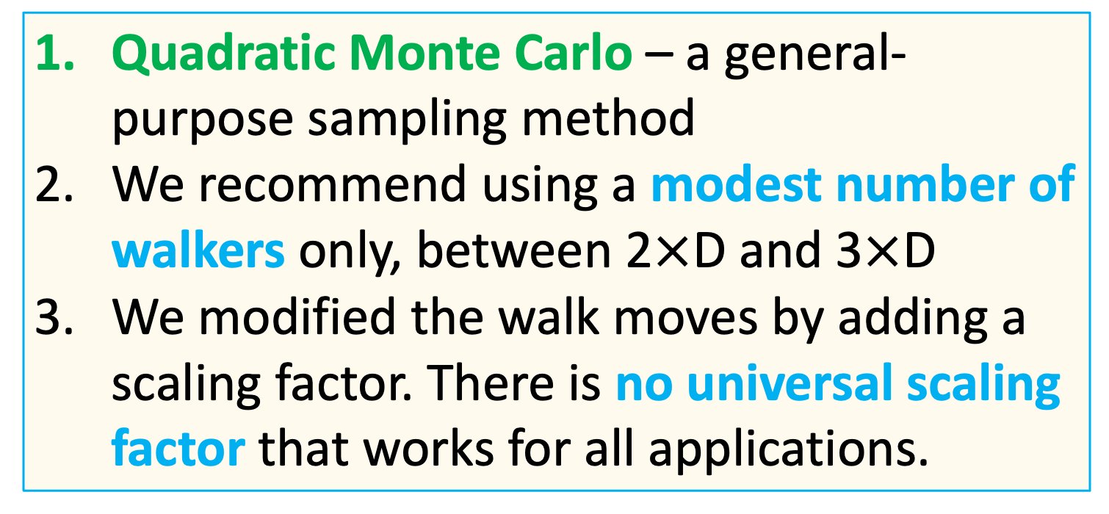
Conclusions for MC Methods
Quadratic Monte Carlo – a general- purpose sampling method
We recommend using a modest number of walkers only, between 2$×$D and 3$×$D
We modified the walk moves by adding a scaling factor. There is no universal scaling factor that works for all applications.

