Slide 1
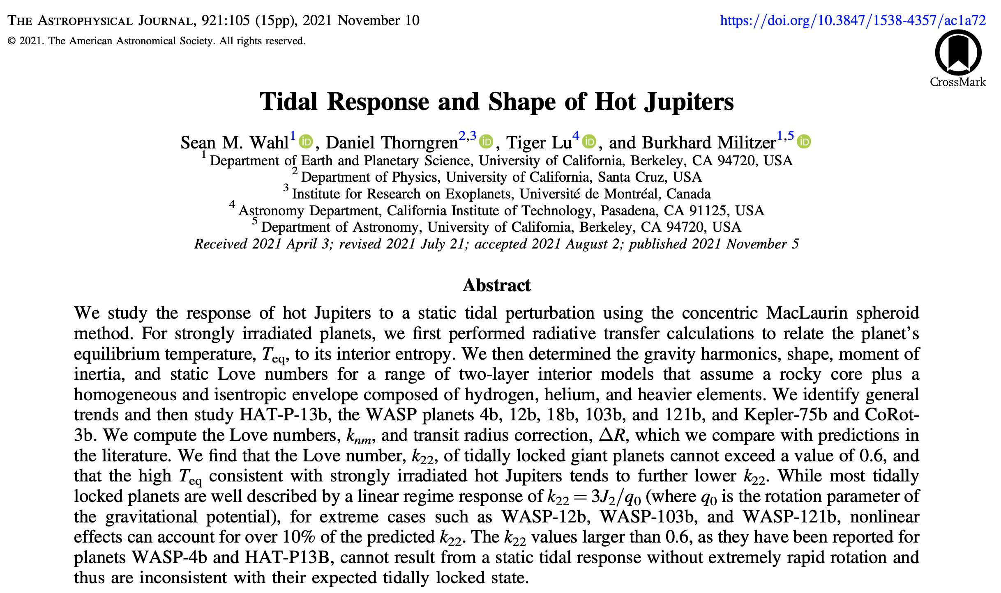
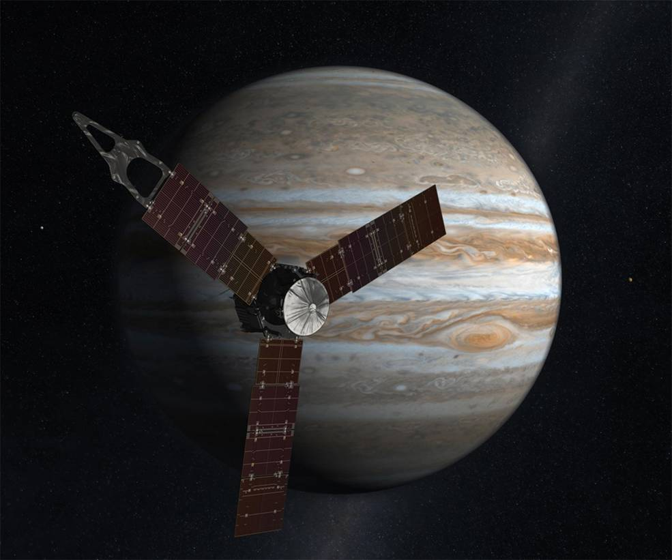
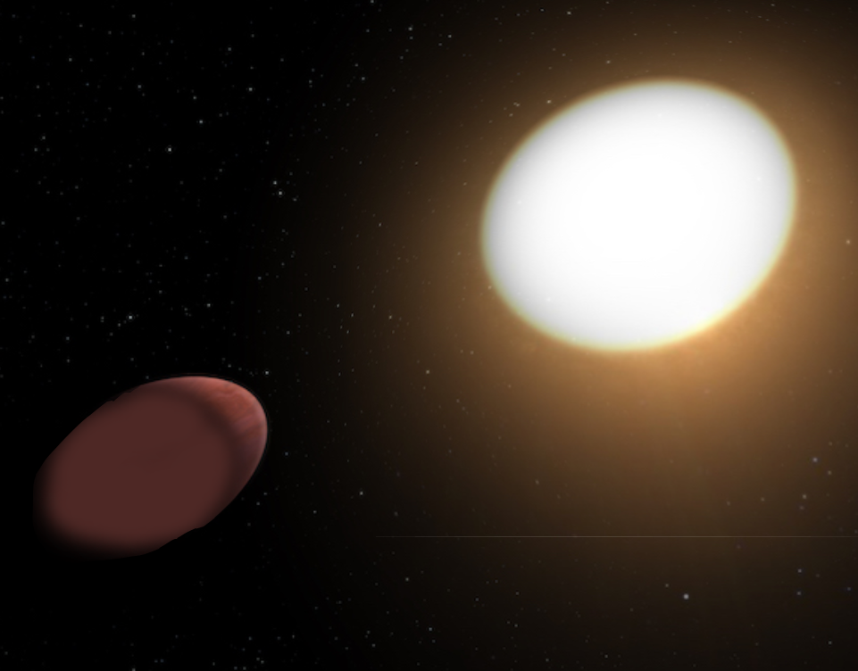
Tidal Response and Shape of Hot Jupiter

Slide 2
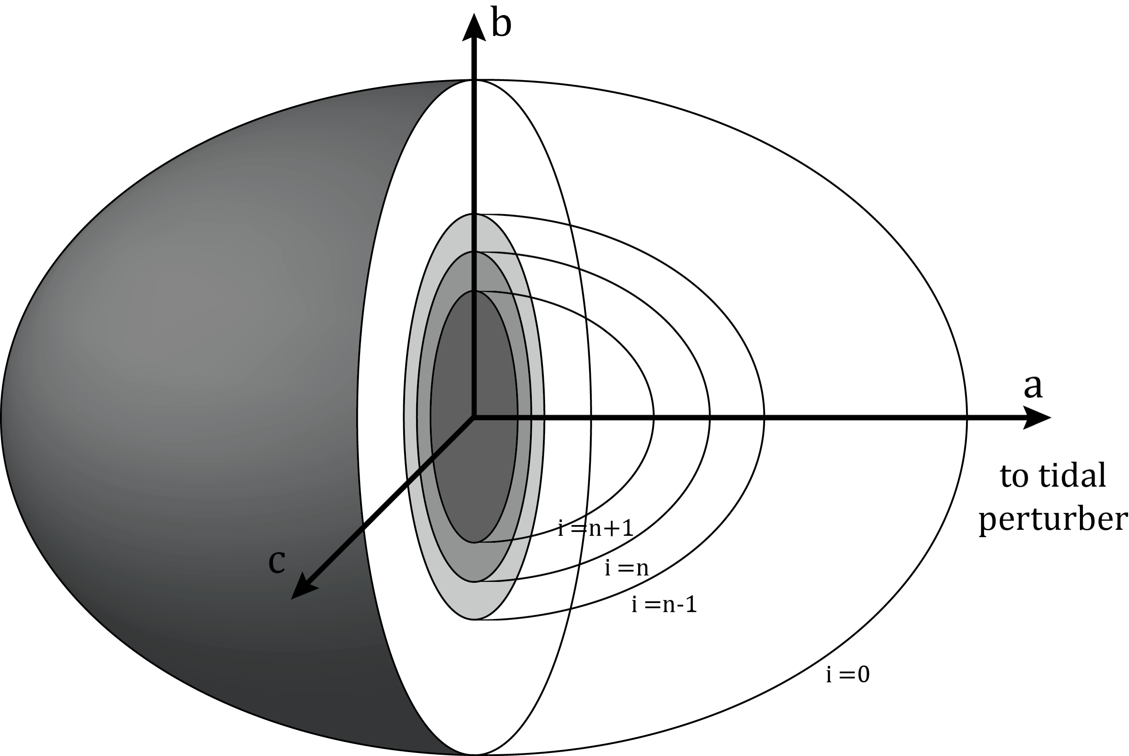
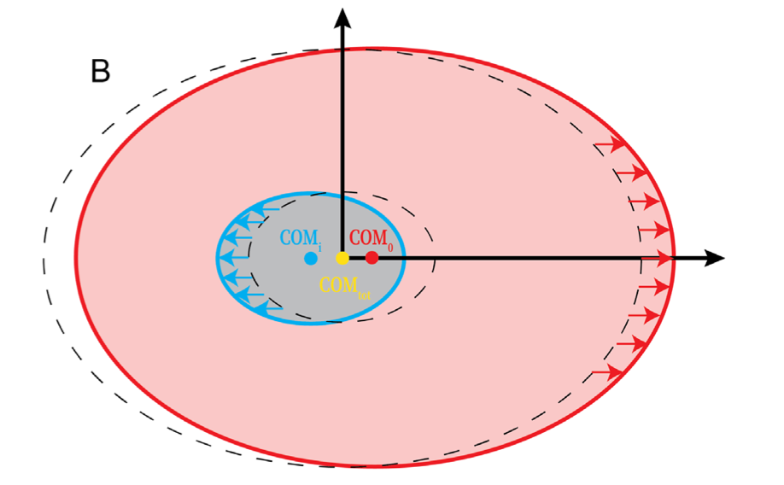
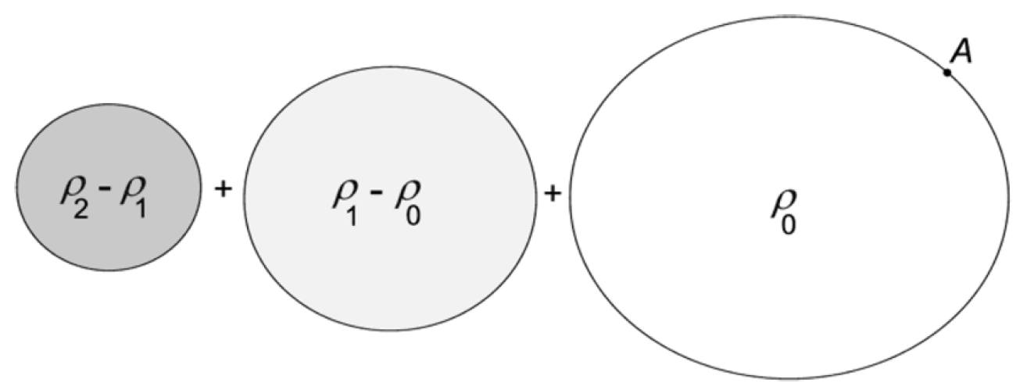
Concentric Maclaurin Spheroid (CMS) theory for rotating bodies
Concentric Maclaurin Spheroid
Method, Hubbard, ApJ (2013)
Accelerated CMS method
Militzer et al, ApJ (2019)

Slide 4
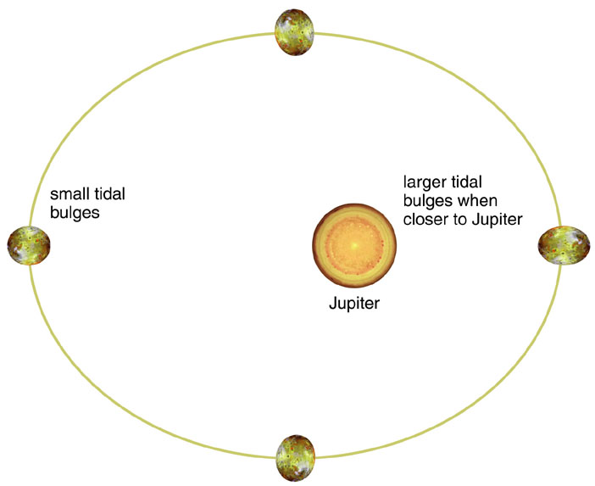
Two types of tidal interactions of giant planets
Planet interacts with orbiting satellites that may introduce dynamic tidal effects.
Static tidal calculation k₂₂=0.590 (Wahl 2020)
Juno mission k₂₂=0.565 ± 0.006
Idini (2021): Coriolis acceleration ∆k₂₂ = −4%
Exoplanet is tidally locked to host star which acts as tidal perturber. Rotation is thus slow.
Planet changes shape. Apparent radius reduced by up to 4%.
Planet’s gravity field changes. (other planets)

Slide 5
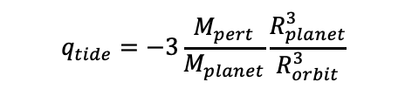
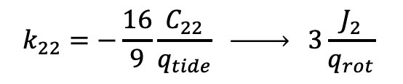

Definition of tidal perturbation. Love number k₂₂
Perturbation of gravity
$$k_{22}=−\frac{16}{9}\frac{C_{22}}{q_{tide}} \underset{→}{ } 3\frac{J_{2}}{q_{rot}}$$
Shape Love number: h = 1 + k₂₂
$$q_{tide}=−3\frac{M_{pert}}{M_{planet}}\frac{R_{planet}^{3}}{R_{orbit}^{3}}$$
$$q_{rot}=\frac{ω^{2}R_{planet}^{3}}{{GM}_{planet}}$$
Planet’s shape and gravity field perturbed
Perturber’s shape and gravity field also changes
Static tides: Infinite time to establish hydrostatic equilibrium. Tidally locked case. Potential theory applies. Often a very good approximation. E.g Jupiter
Dynamic tides: Orbital frequency and rotation frequency differ. Perturber supplies energy. Tidal heating strong if orbits eccentric.

Slide 6
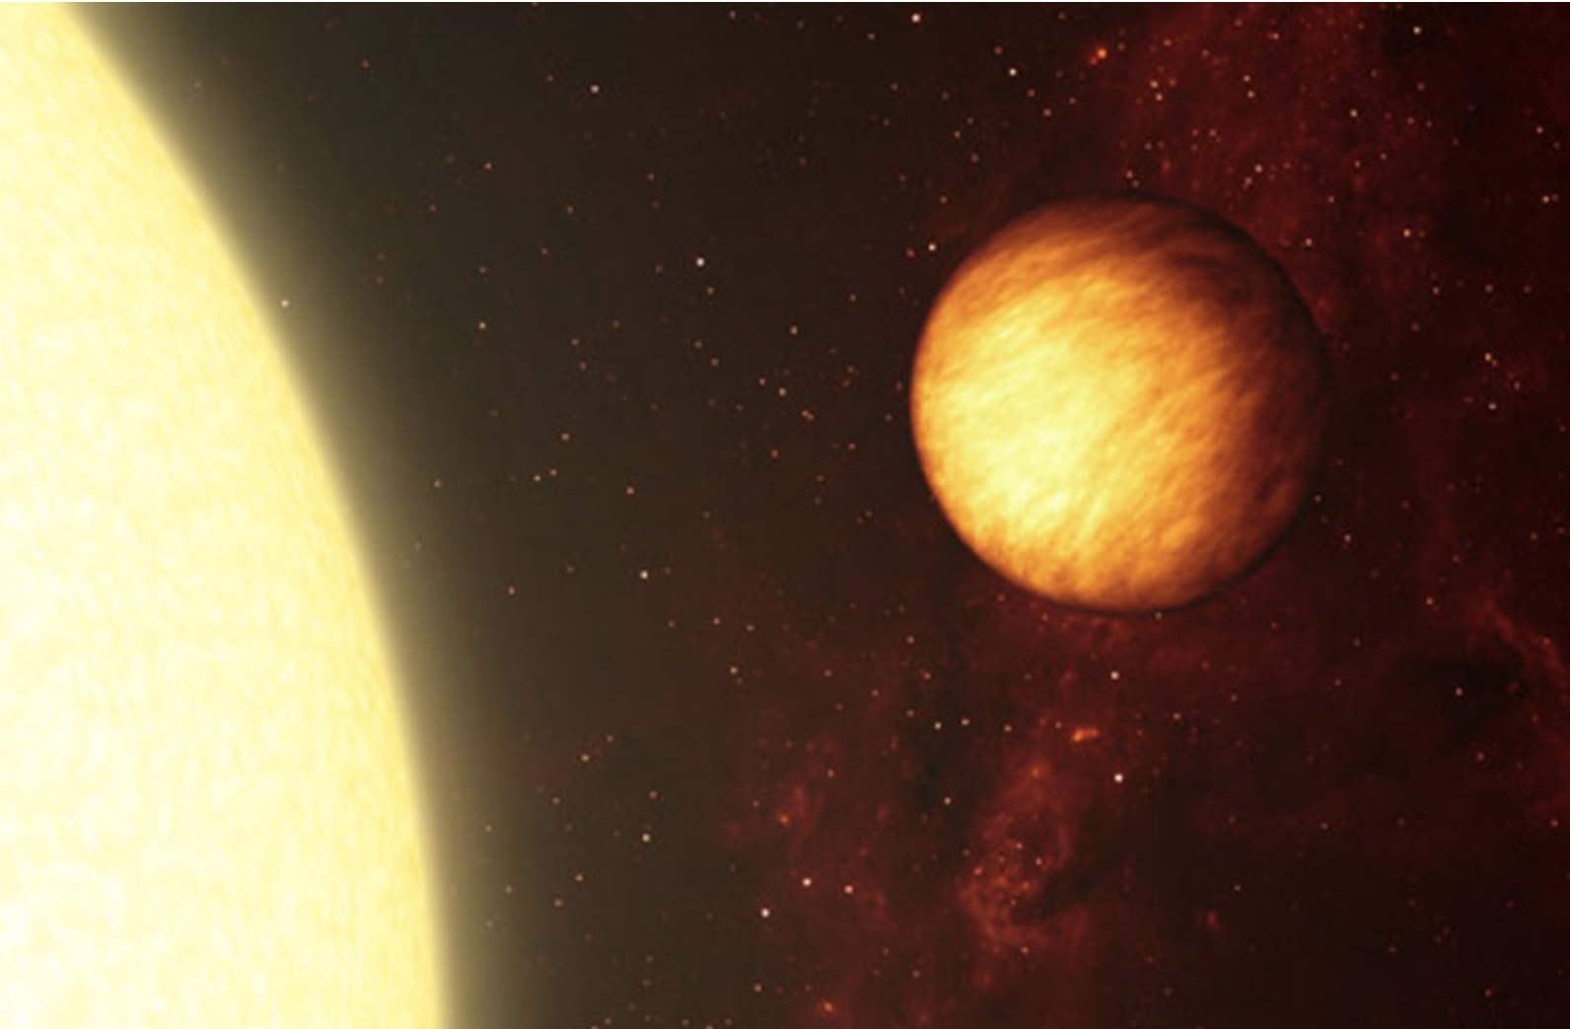
Interior Models of Strongly Irradiated Giant Exoplanets Constructed with CMS Method
We first performed radiative transfer calculations to relate the planet’s equilibrium temperature, T_{eq}, to its interior entropy. (Thorngren & Fortney, 2018, AJ, 155, 214)
Planets tidally locked to host star. Rotation is thus slow.
Constructed Interior models with homogenous envelopes with CMS.
Match mass and radius under two assumptions
  a) No core, all Z in envelope
  b) Maximal core, no Z in envelope
A. Hurt

Slide 7
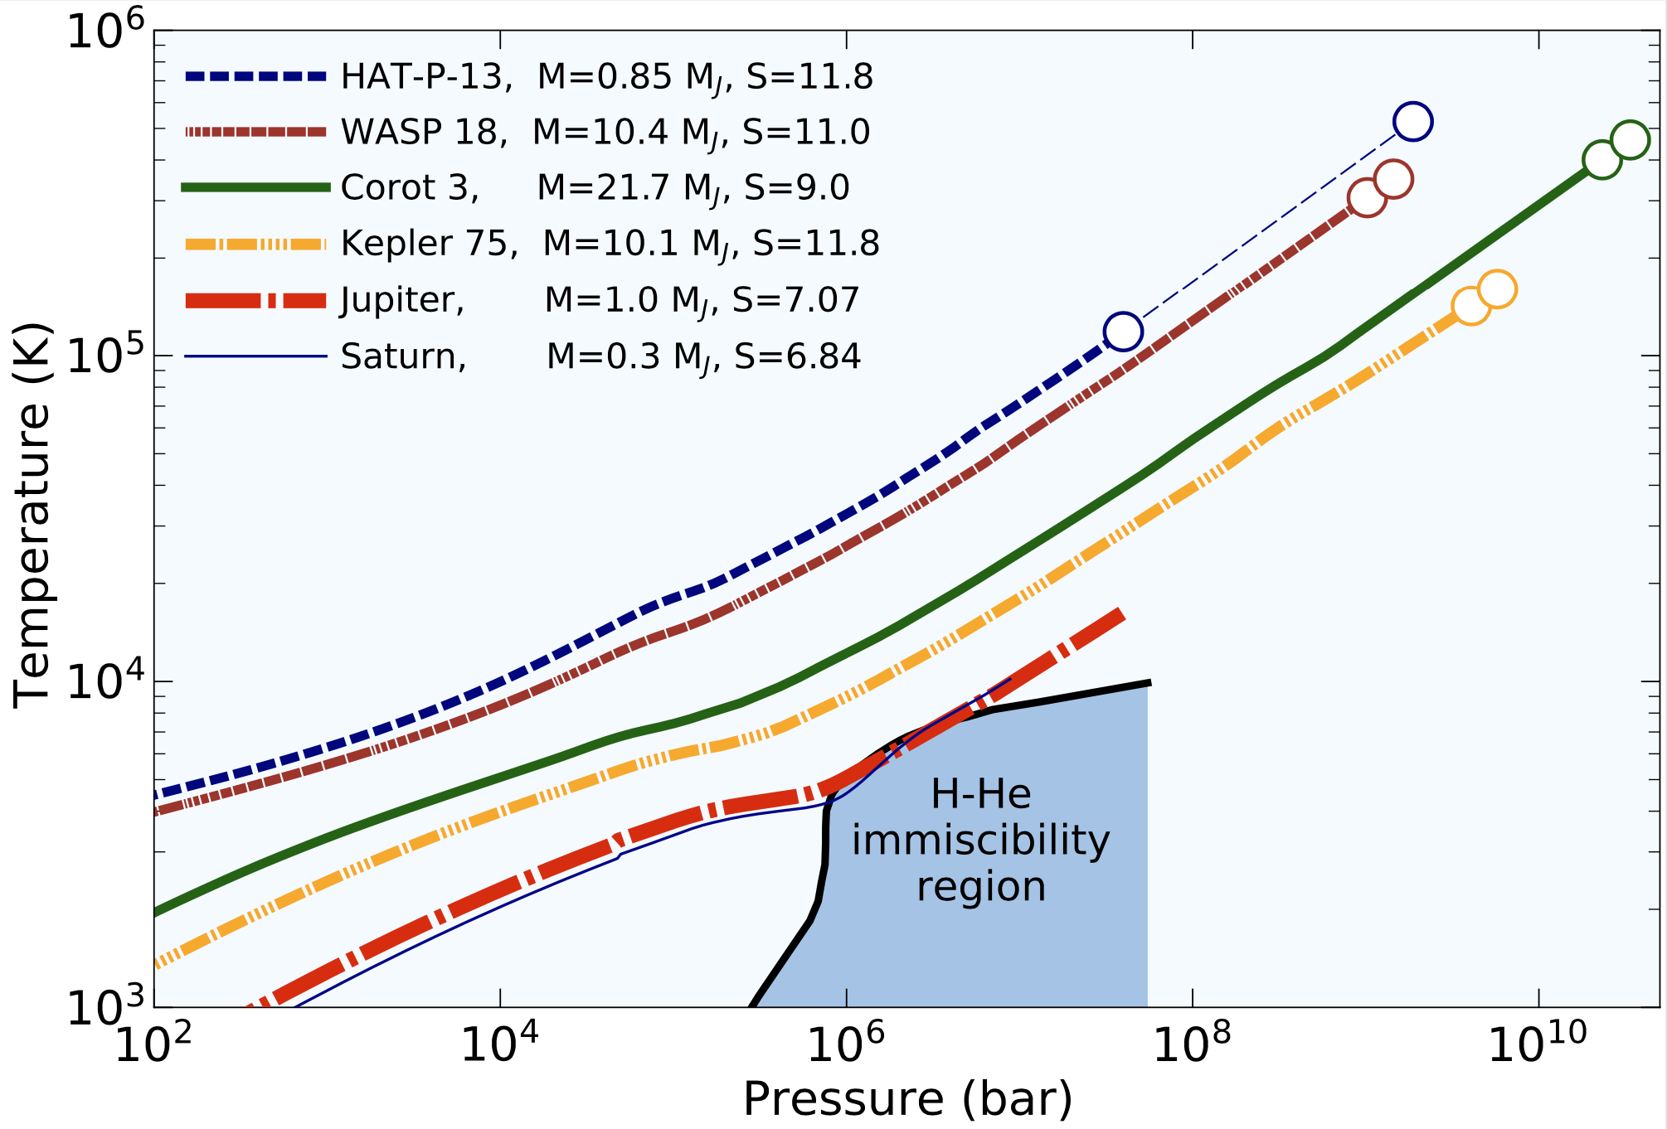
Interior Models of Strongly Irradiated Giant Exoplanets Constructed with CMS Method
We first performed radiative transfer calculations to relate the planet’s equilibrium temperature, T_{eq}, to its interior entropy. (Thorngren & Fortney, 2018, AJ, 155, 214)
Planets tidally locked to host star. Rotation is thus slow.
Constructed Interior models with homogenous envelopes with CMS.
Match mass and radius under two assumptions
  a) No core, all Z in envelope
  b) Maximal core, no Z in envelope

Slide 8
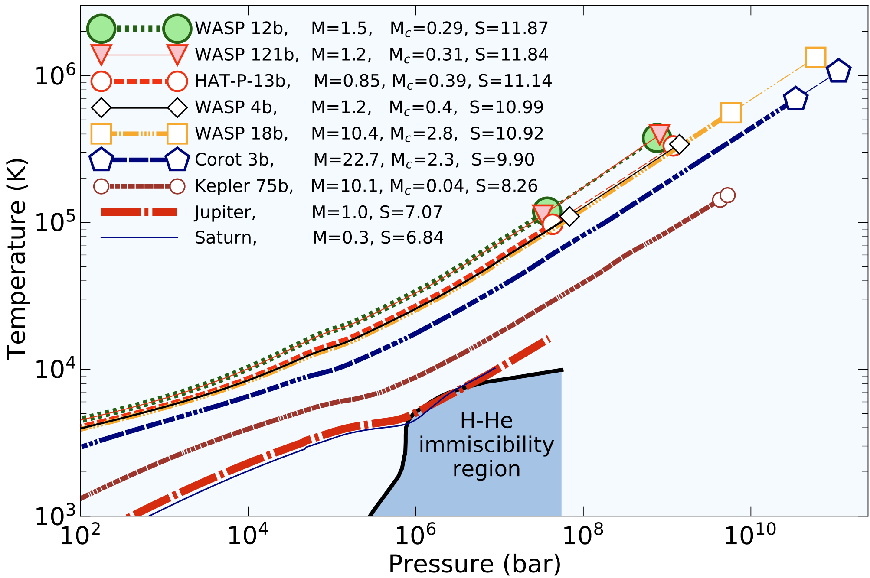
Interior Models of Strongly Irradiated Giant Exoplanets Constructed with CMS Method
We first performed radiative transfer calculations to relate the planet’s equilibrium temperature, T_{eq}, to its interior entropy. (Thorngren & Fortney, 2018, AJ, 155, 214)
Planets tidally locked to host star. Rotation is thus slow.
Constructed Interior models with homogenous envelopes with CMS.
Match mass and radius under two assumptions
  a) No core, all Z in envelope
  b) Maximal core, no Z in envelope

Slide 9
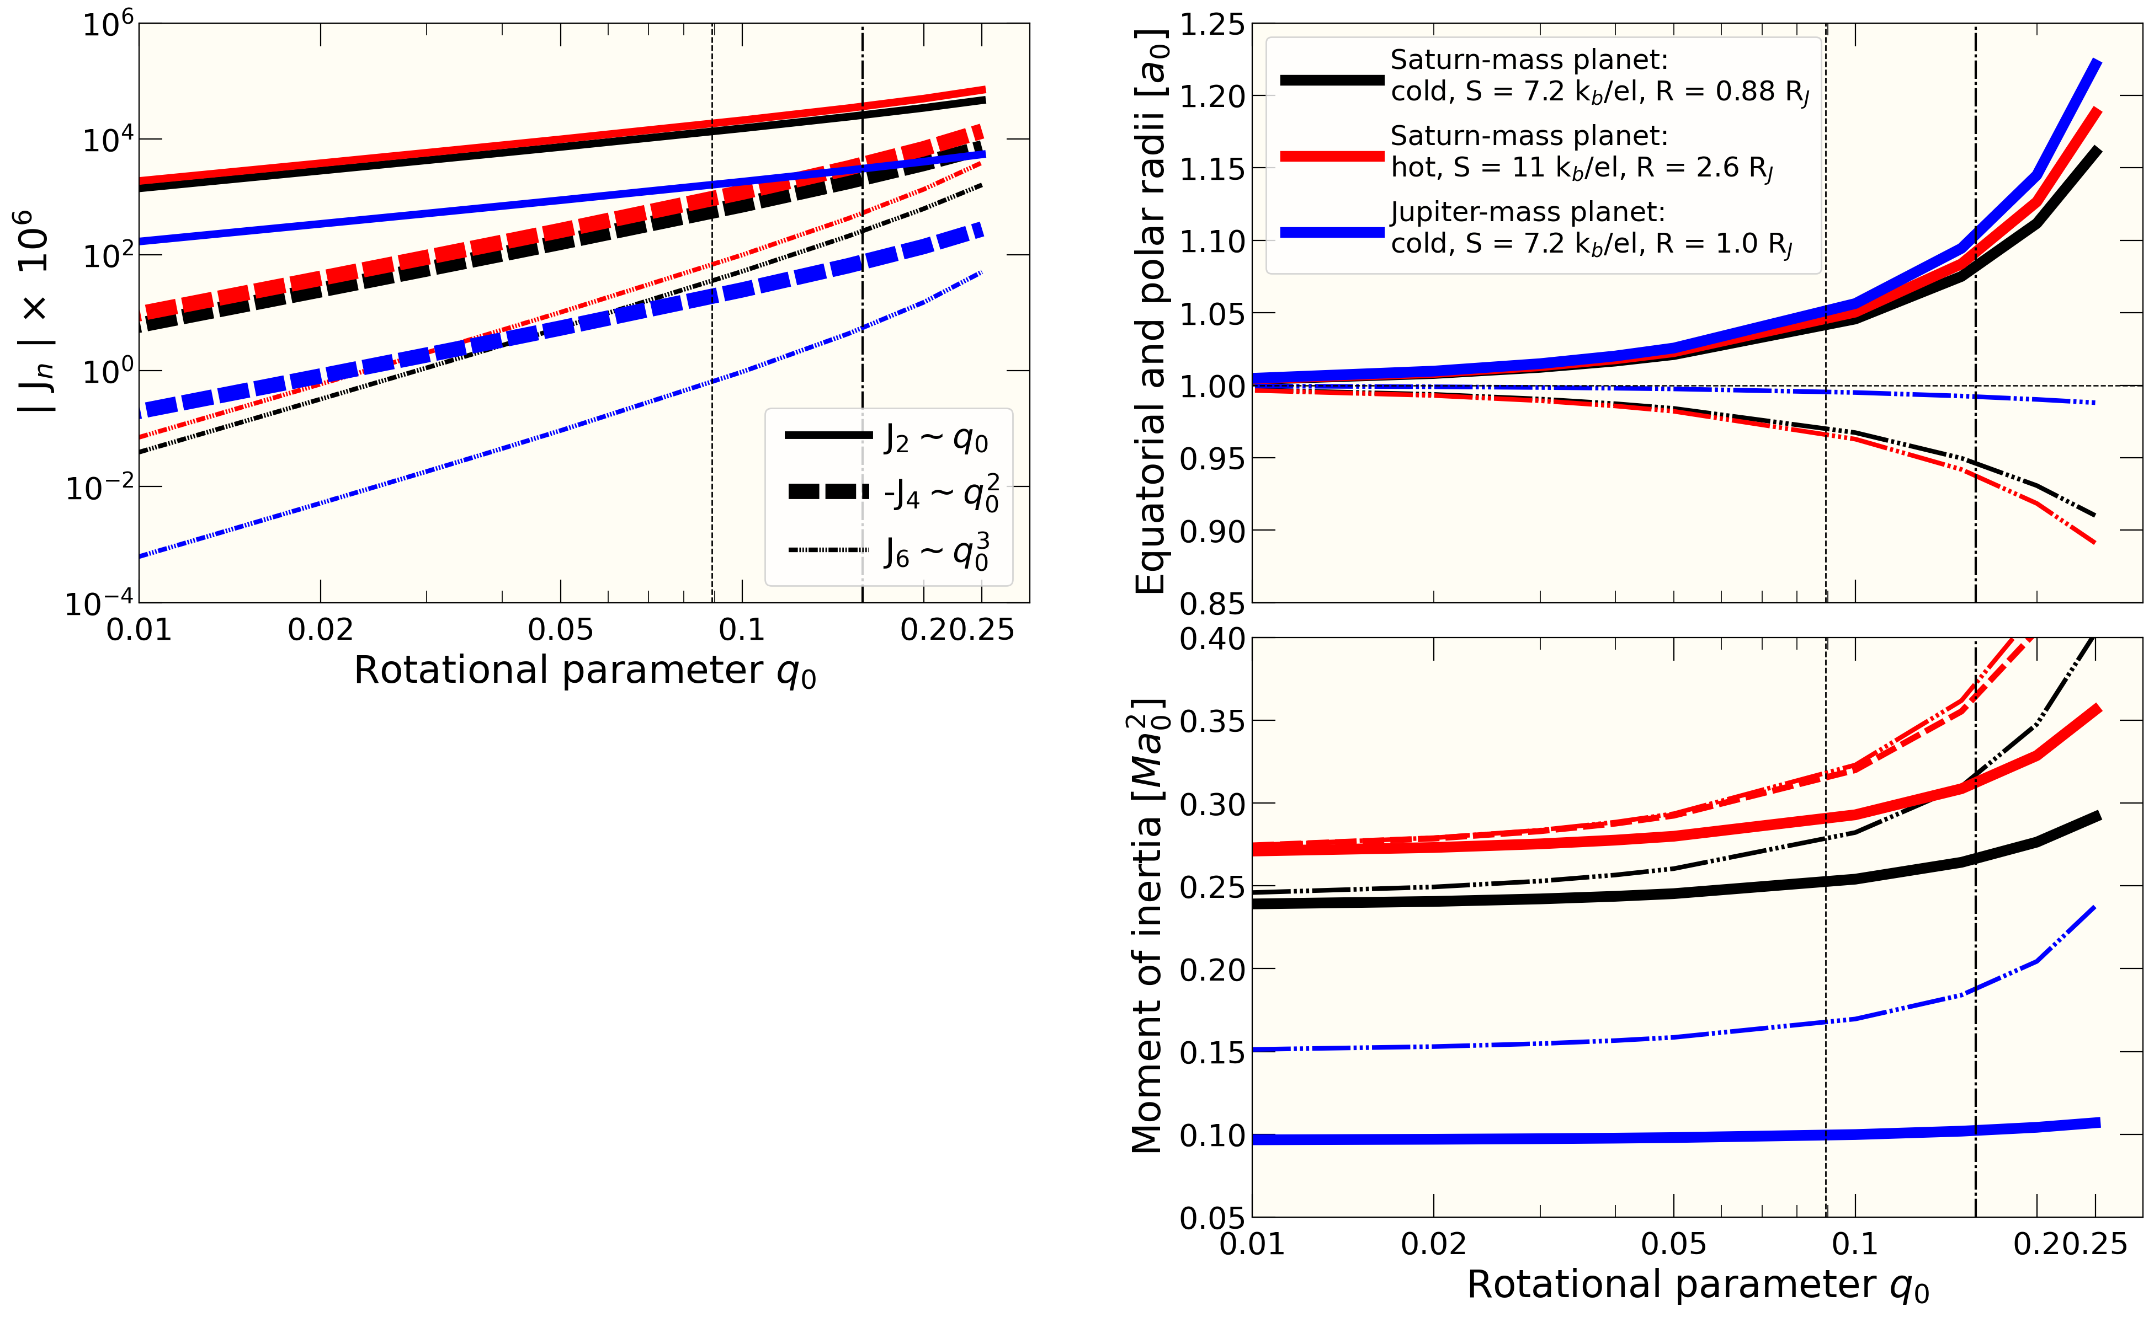

Interior Models of Strongly Irradiated Giant Exoplanets Constructed with CMS Method
Slowly rotating regime: $J_{n}\sim q_{rot}^{n/2}$
Darwin-Radau does not work for giant planets

Slide 10
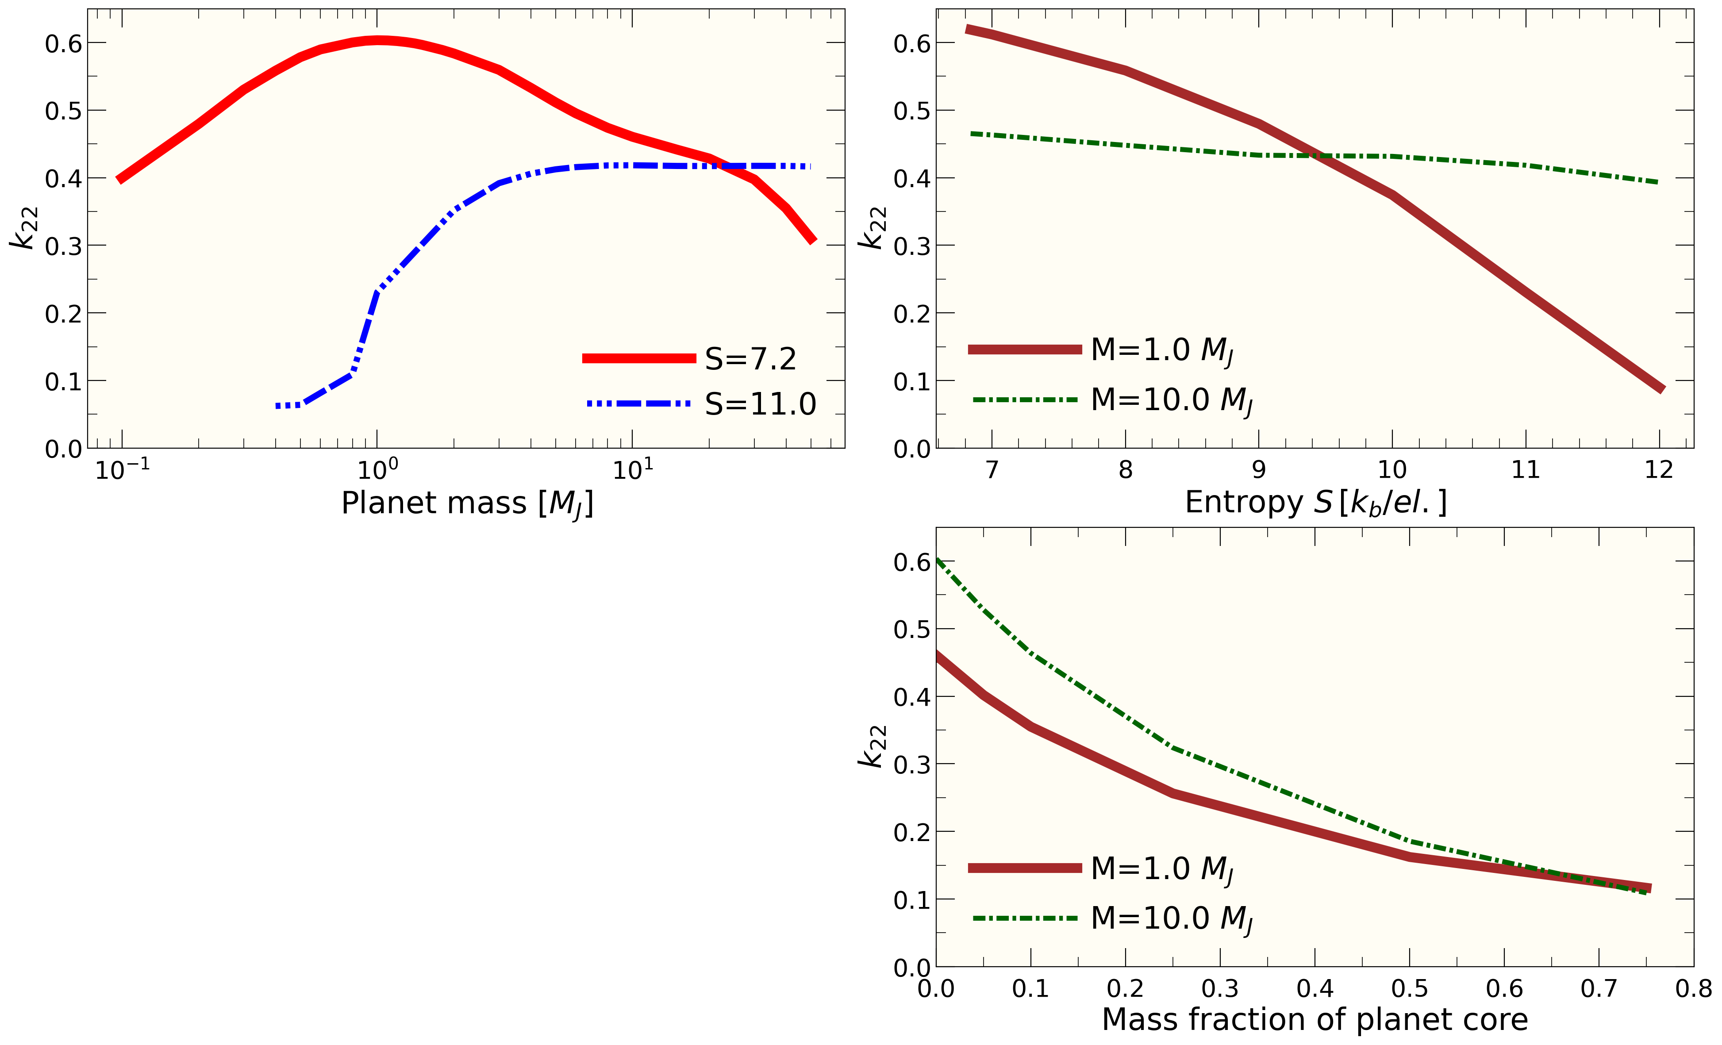

Interior Models of Strongly Irradiated Giant Exoplanets Constructed with CMS Method
$k_{22}$ is sensitive to planet mass and entropy
Only if both are kept fixed, a simple correlation between $k_{22}$ and core mass fraction emerges that has been cited as a way to infer the core mass of exoplanets (Batygin 2006, Ragozzine & Wolf 2009)

Slide 11
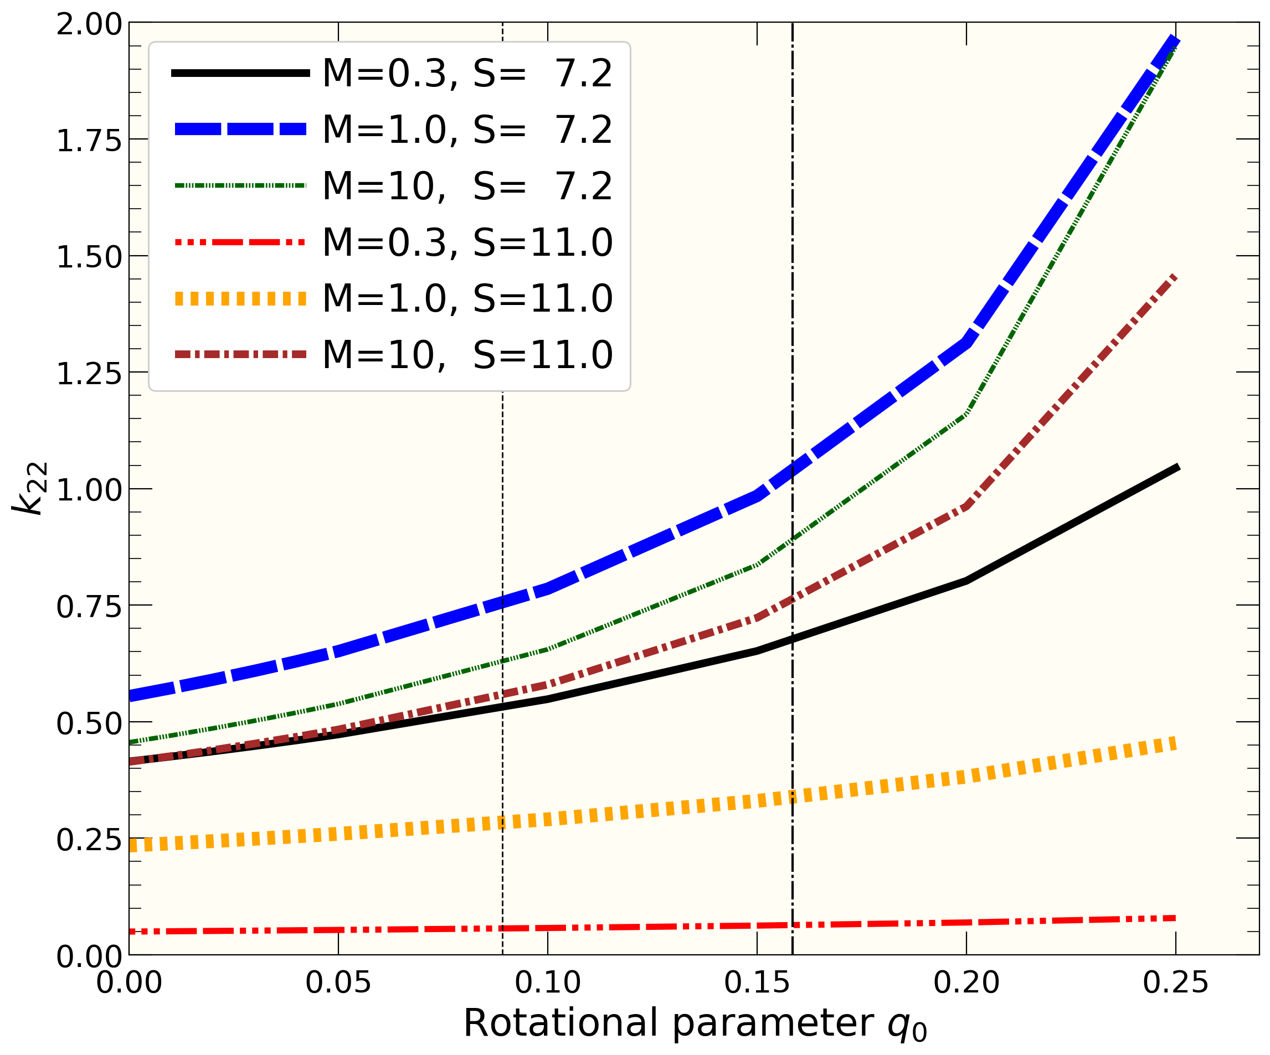
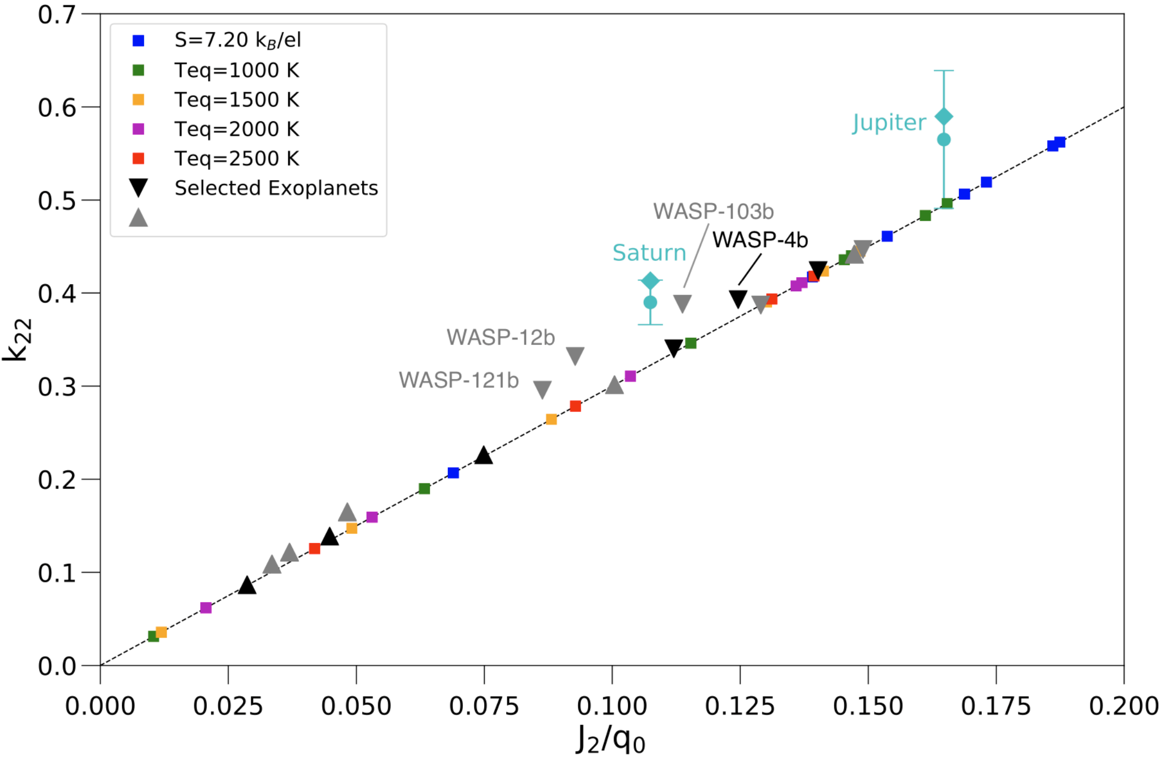


A) Nonlinear Regime of Rapid Rotation
B) Linear Regime of Slow Rotation
Regime of rapid rotation: k₂₂ varies nonlinearly.
Linear regime of slow rotation: $k_{22} \sim J_{2} /{ q}_{rot}$

Slide 12
O$bservations predict a large range of k_{22}$values
Uniform density planet k₂₂=1.5

Slide 13

Interior models predict $k_{22}≤0.6$.
So all observations with large $k_{22} c$annot be matched.
Uniform density planet k₂₂=1.5

Slide 14
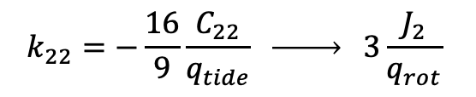
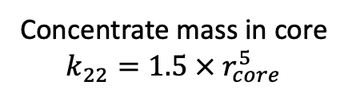

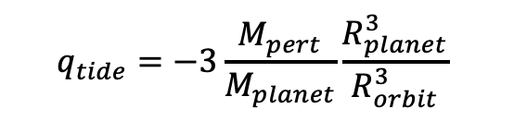
Why does k₂₂ depend on core mass fraction?
Definition
$$k_{22}=−\frac{16}{9}\frac{C_{22}}{q_{tide}} \underset{→}{ } 3\frac{J_{2}}{q_{rot}}$$
$$q_{tide}=−3\frac{M_{pert}}{M_{planet}}\frac{R_{planet}^{3}}{R_{orbit}^{3}}$$
$$q_{rot}=\frac{ω^{2}R_{planet}^{3}}{{GM}_{planet}}$$
Uniform density planet
k₂₂=1.5
Concentrate mass in core
$$k_{22}=1.5 × r_{core}^{5}$$

Slide 15
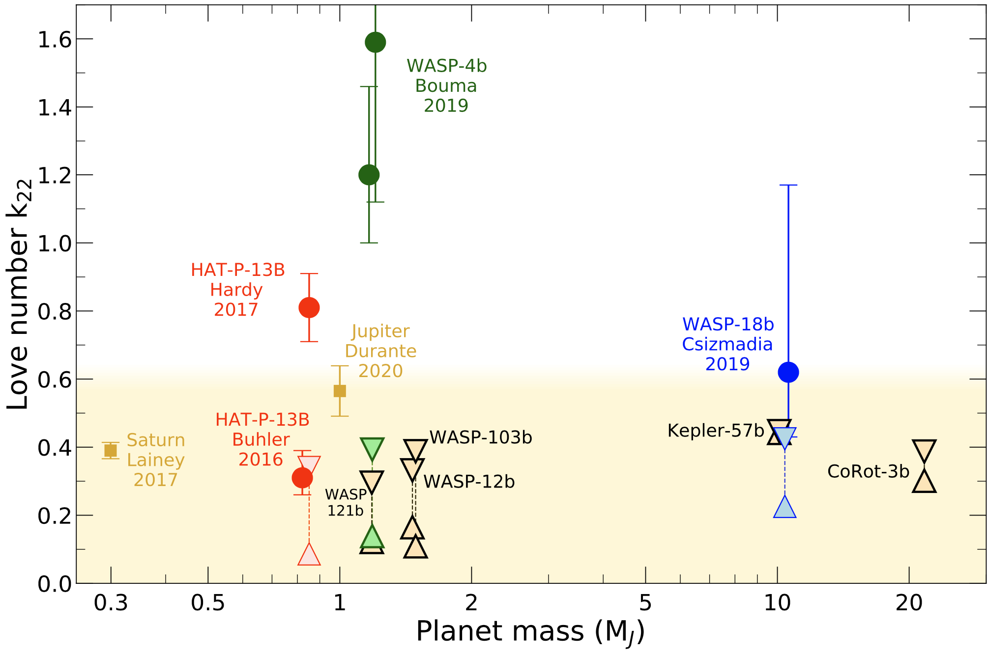
Conclusion
All existing measurements/predictions with k₂₂>0.6 are unrealistic. Density changes too much throughout a giant planet’s interior.
Observations need to be reinterpreted. Bouma (2020) attributes TTV to an unseen companion of WASP-4B.
k₂₂ is affected by planet mass, core mass, and interior entropy.
Tides change a planet’s shape. The apparent radius is smaller than that of an unperturbed planet by up to 4%.

