Slide 1
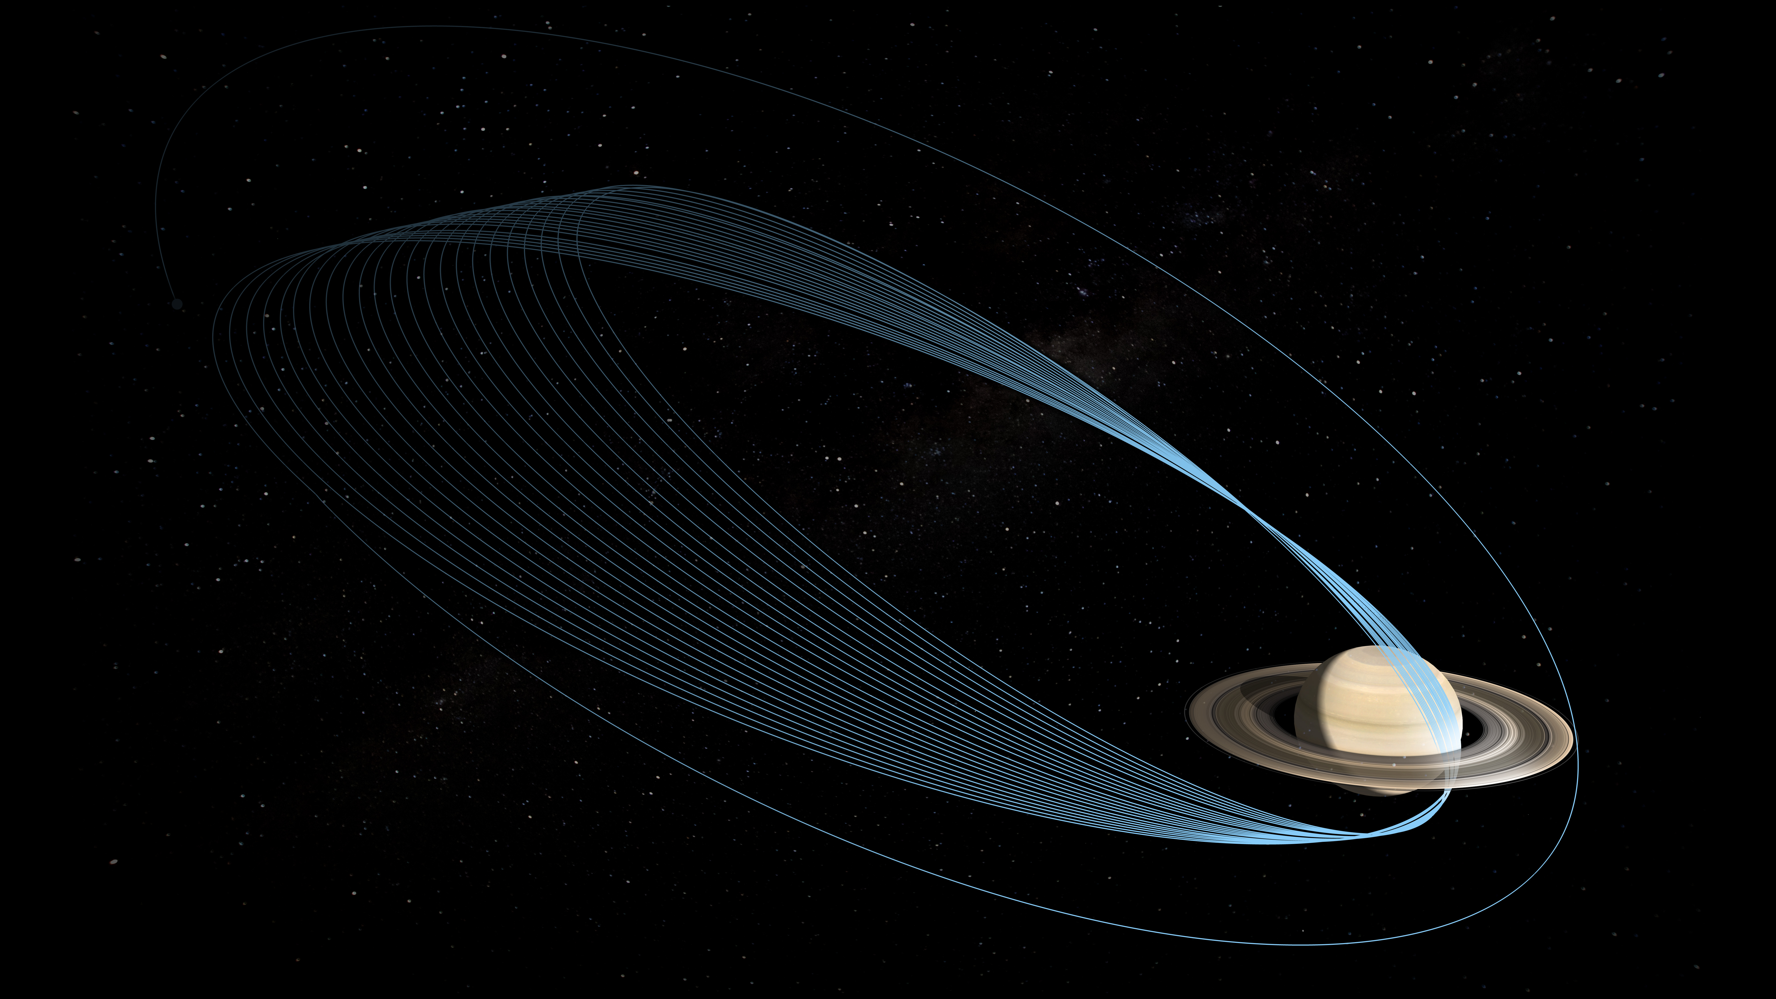
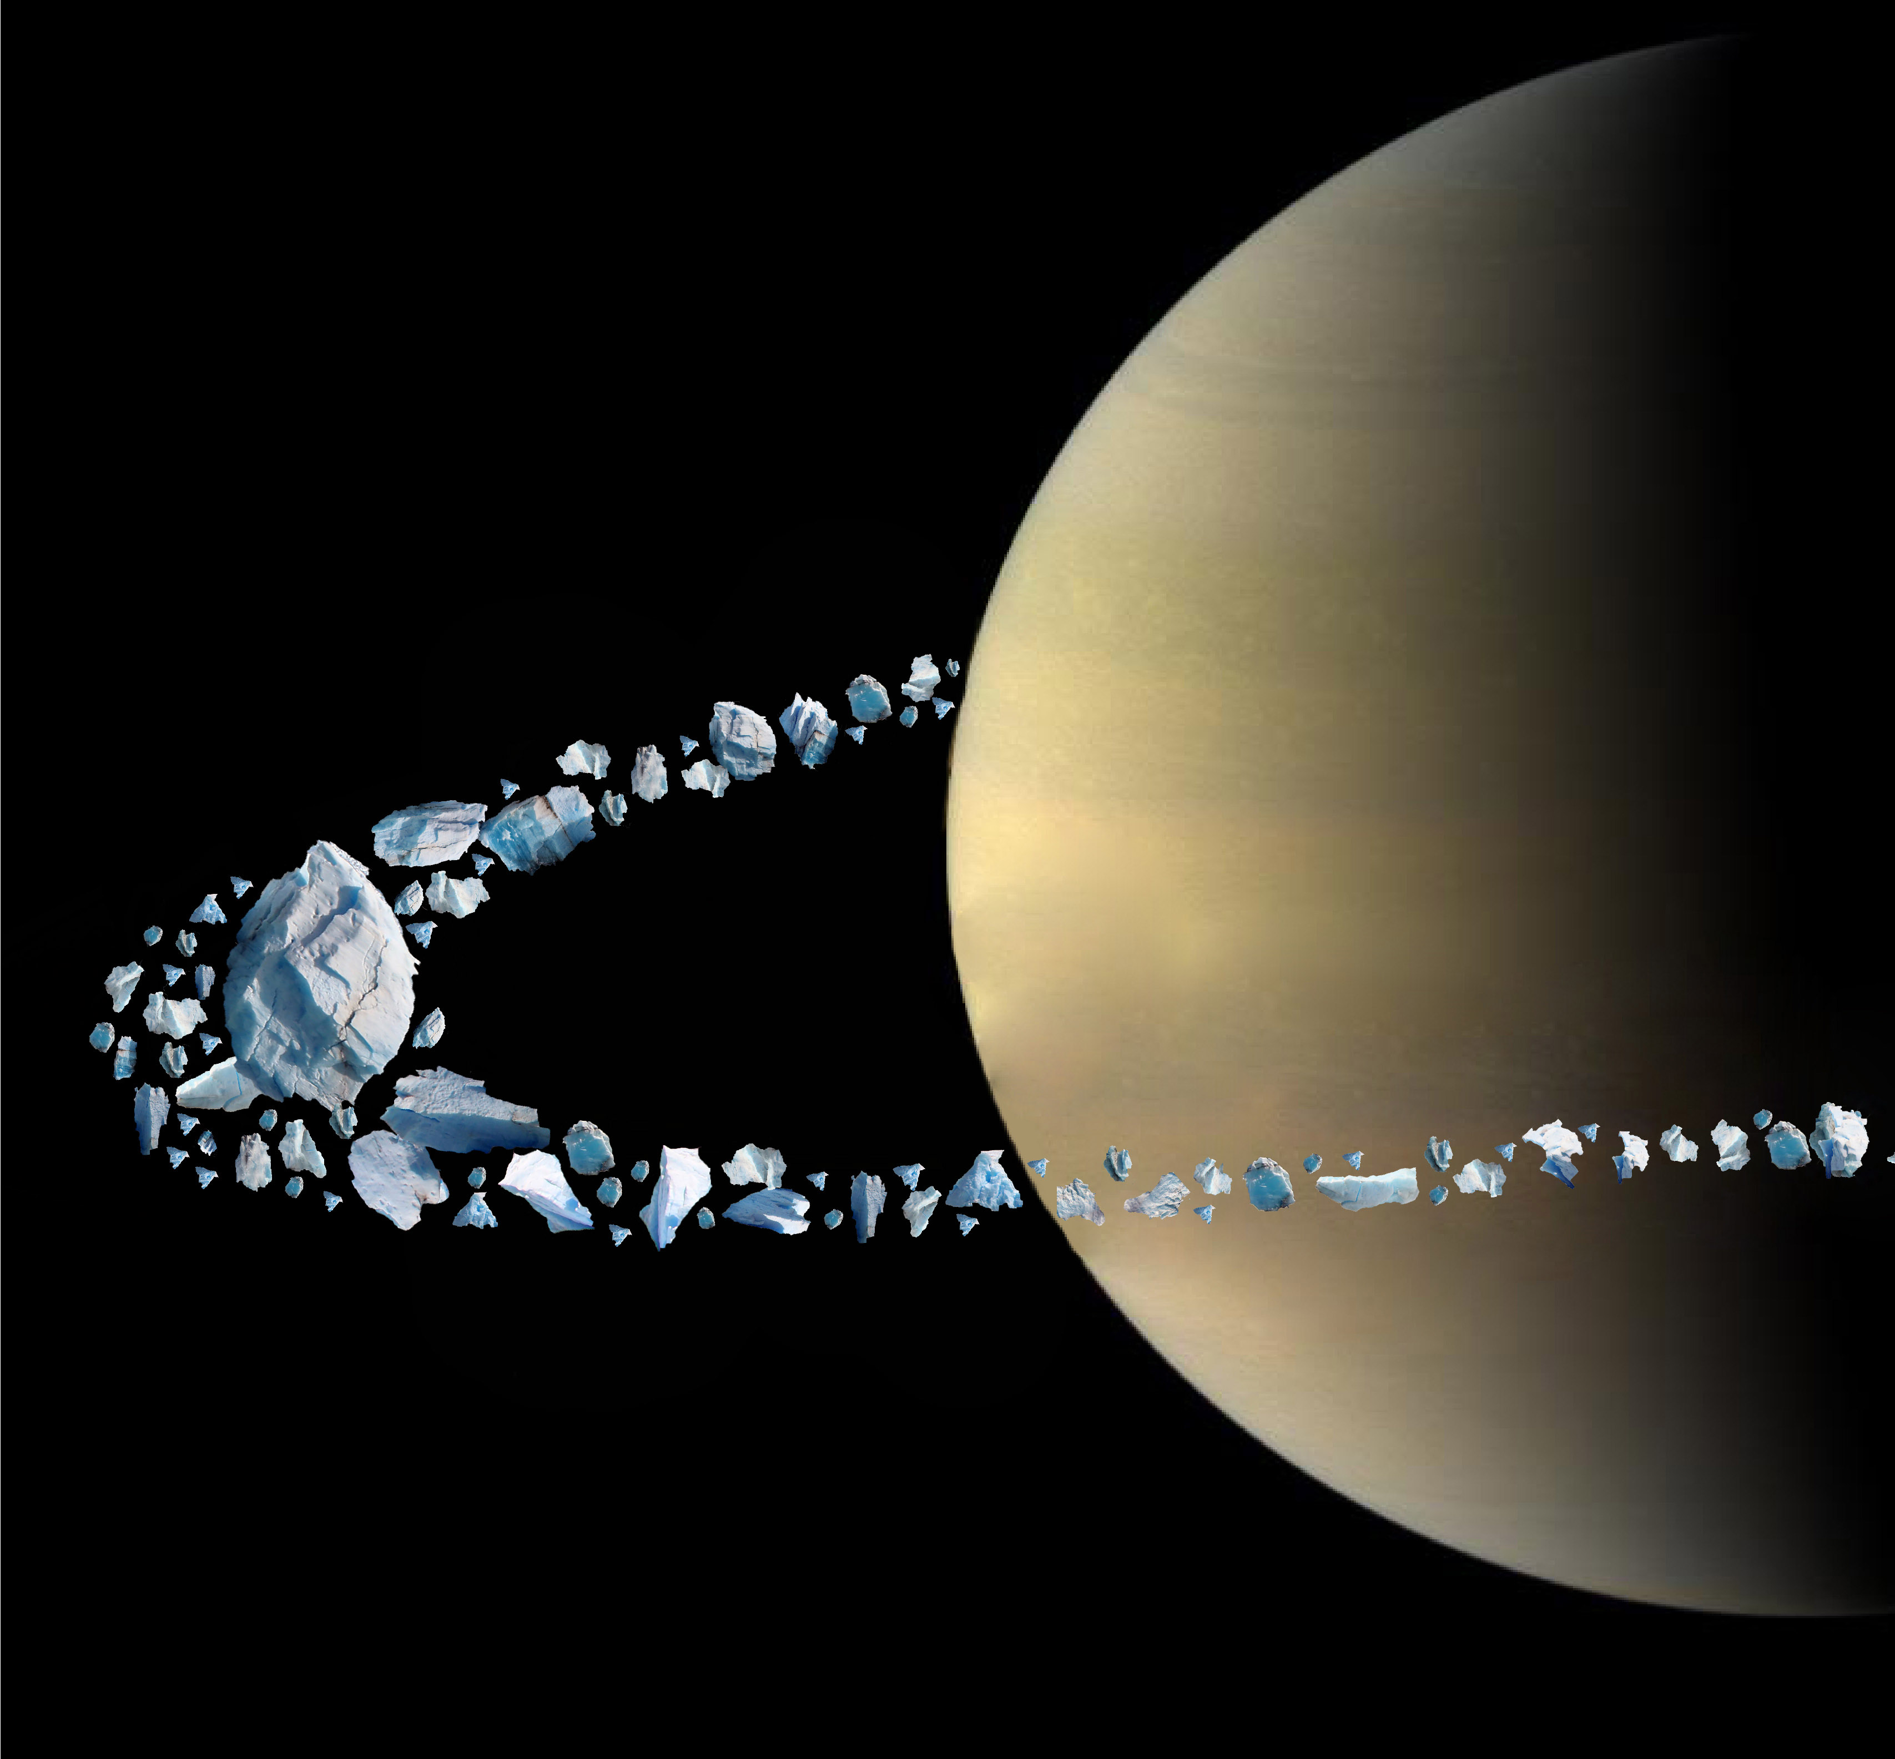
The Origin of Saturn’s Obliquity and Young Rings
B. Militzer, W. B. Hubbard, J. Wisdom, R. Dbouk,
F. Nimmo, B. Downey, R. French
UC Berkeley
U Arizona
MIT
MIT
UCSC
UCSC
Wellesley

Slide 2
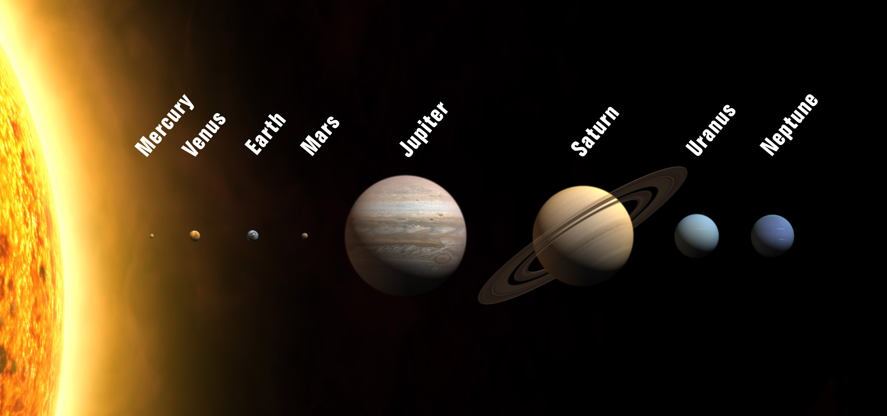
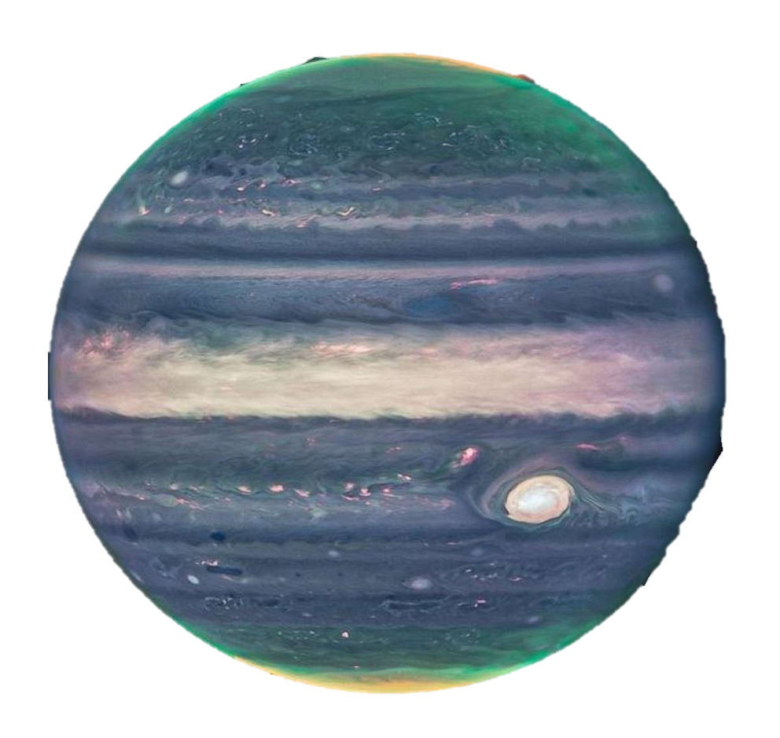
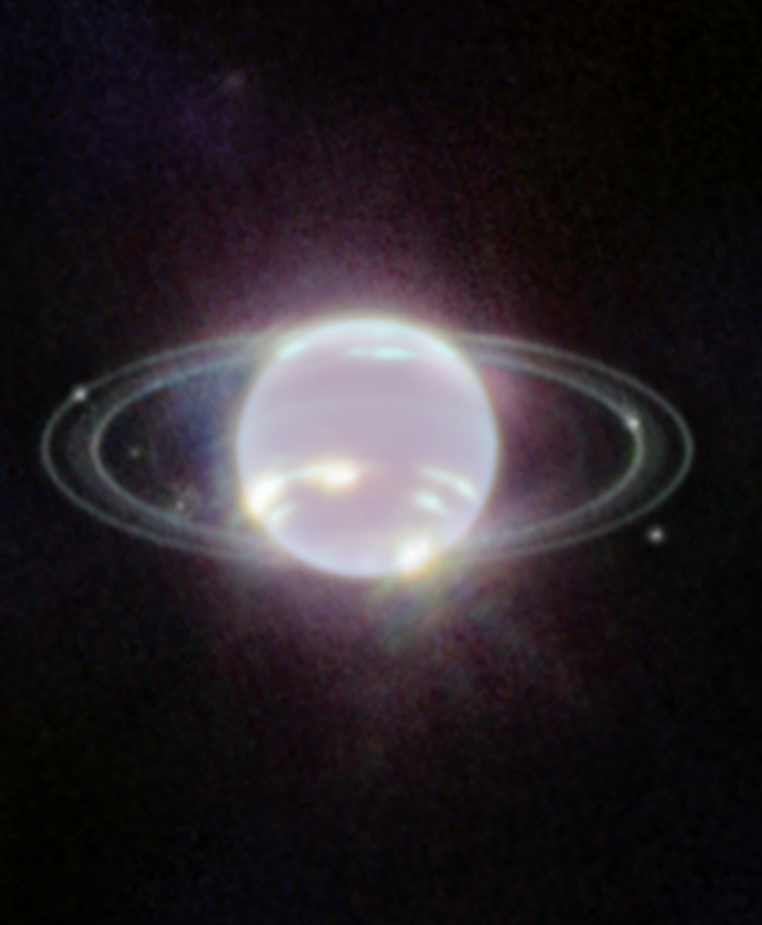
What is so Unusual About Planet Saturn?

Slide 3
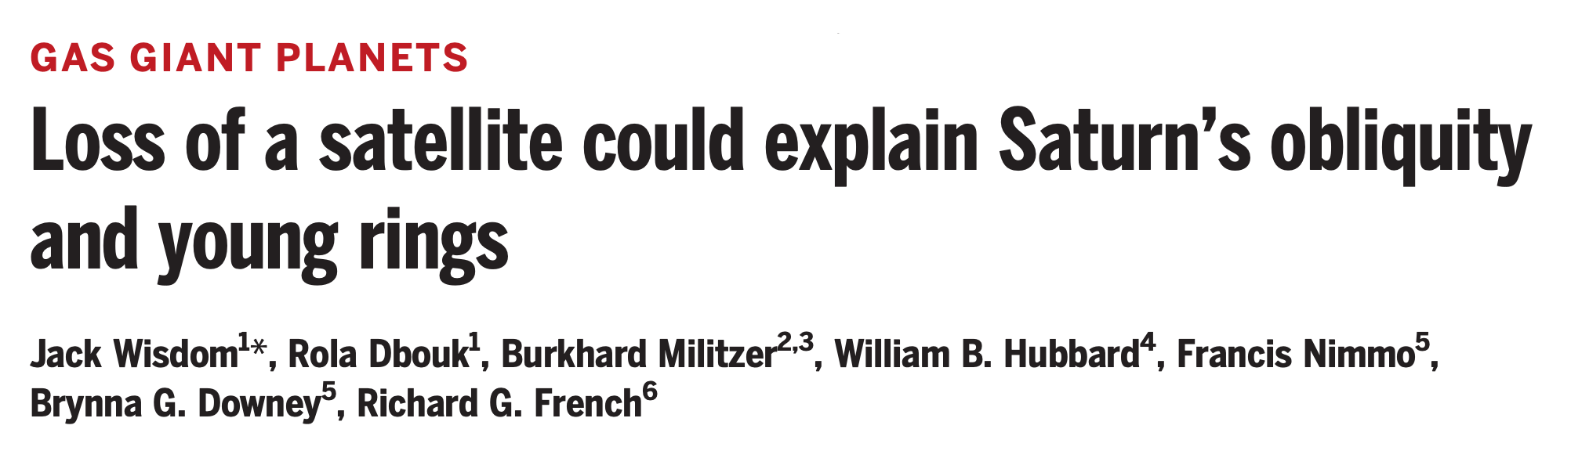
How did Saturn become the Lord of the Rings?

Slide 4
What is so unusual about Planet Saturn?
Gravity field measured
Winds are 9000 km deep.
Rings are only 100 million years old.

Slide 5
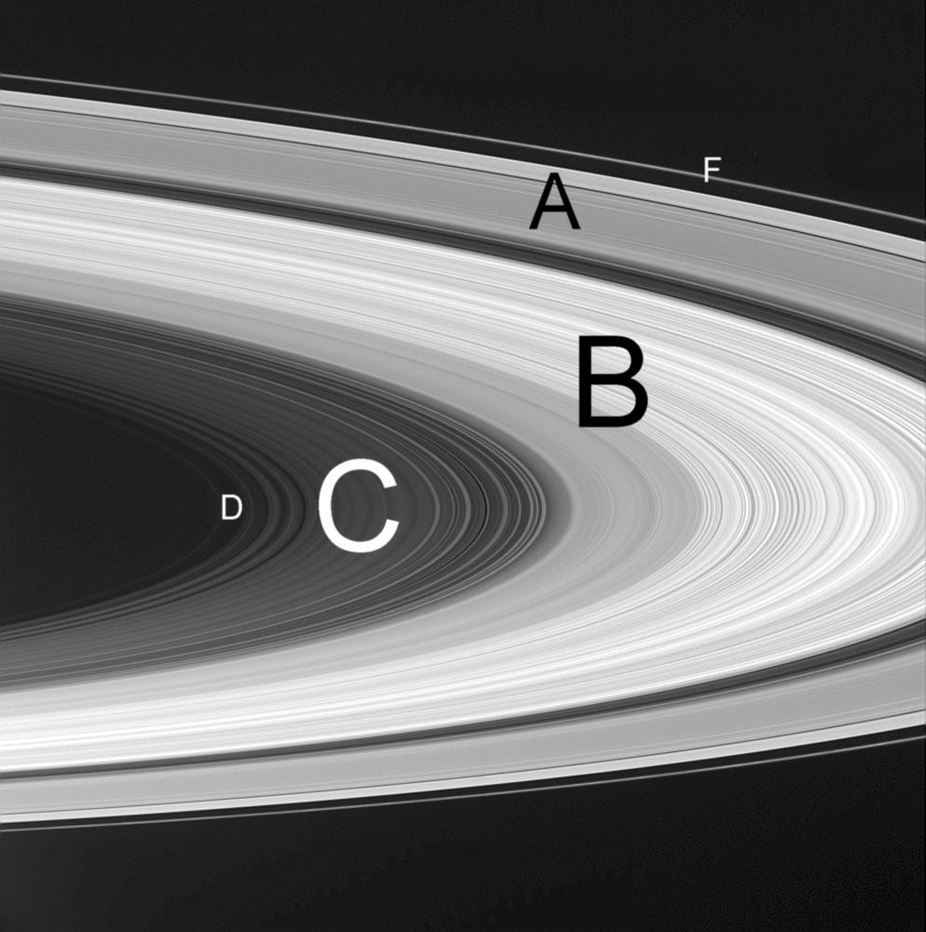
Mass of Saturn’s Rings Measured
Saturn’s rings labeled A-F

Slide 6
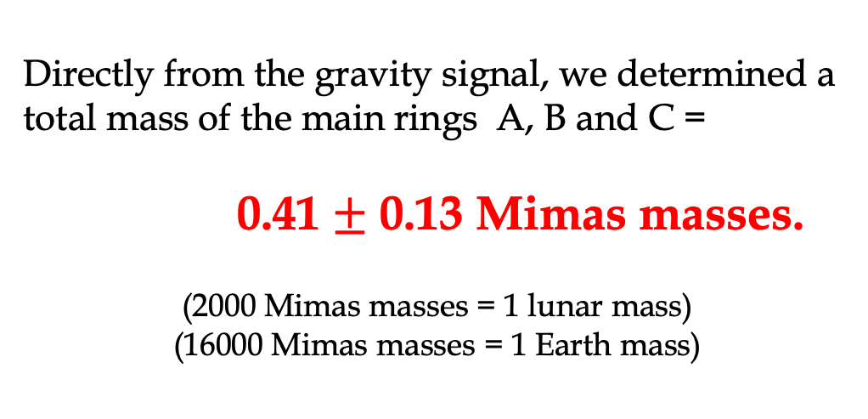
First Determination of
Saturn’s Ring Mass from Gravity
Directly from the gravity signal, we determined a total mass of the main rings A, B and C =
0.41 $±$ 0.13 Mimas masses.
(2000 Mimas masses = 1 lunar mass)
(16000 Mimas masses = 1 Earth mass)
Iess, BM, et al. Science (2019)

Slide 7
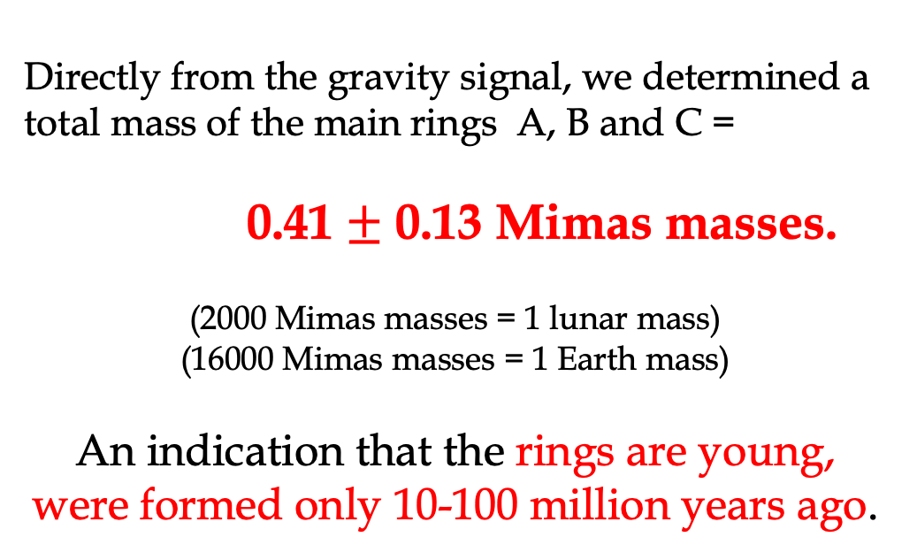
First Determination of
Saturn’s Ring Mass from Gravity
Directly from the gravity signal, we determined a total mass of the main rings A, B and C =
0.41 $±$ 0.13 Mimas masses.
(2000 Mimas masses = 1 lunar mass)
(16000 Mimas masses = 1 Earth mass)
An indication that the rings are young, were formed only 10-100 million years ago.
Iess, BM, et al. Science (2019)

Slide 8
What is a Cassini State?
What is a Cassini State?
Answer: Spin-Orbit Coupling between Planets or Moons

Slide 9
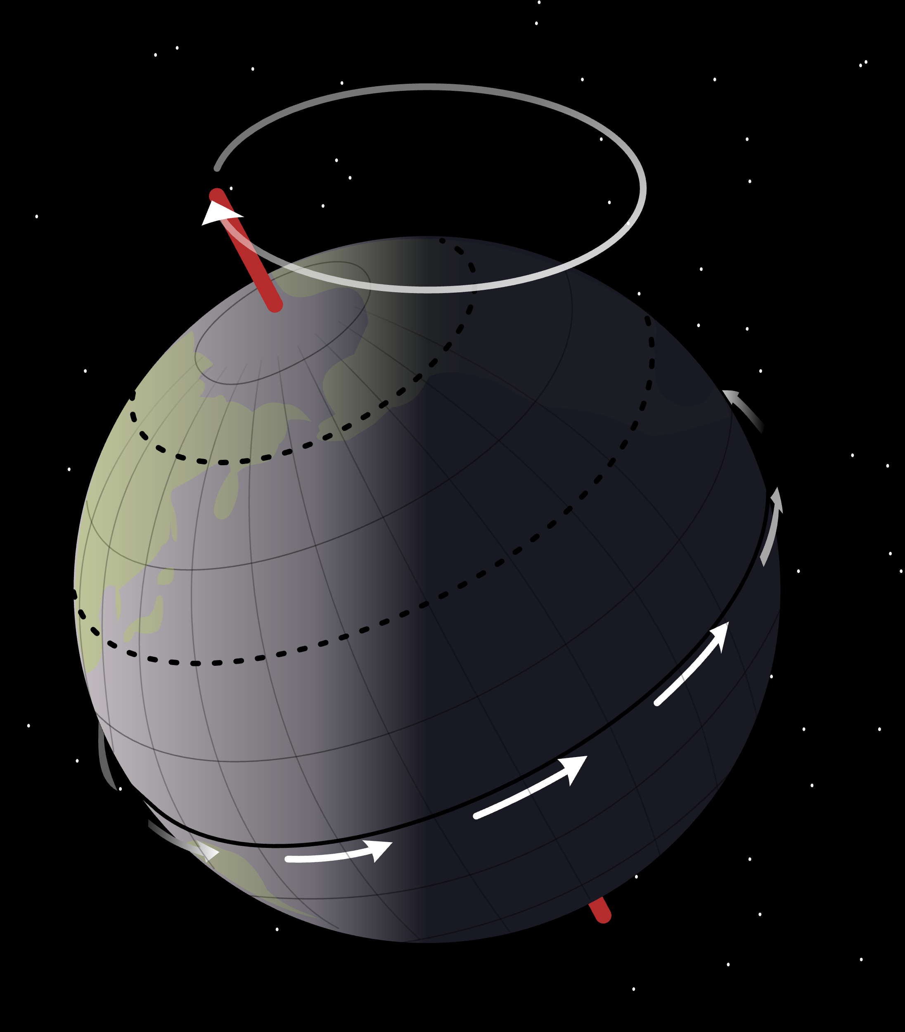
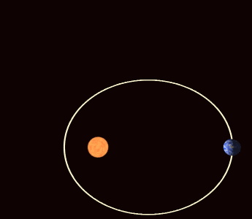
Example for Cassini State: Mercury’s Orbit Around the Sun

Slide 10
Spin-Orbit Coupling
Satellite
Planet

Slide 11
Spin-Orbit Coupling

Slide 12
Spin-Orbit Coupling

Slide 13
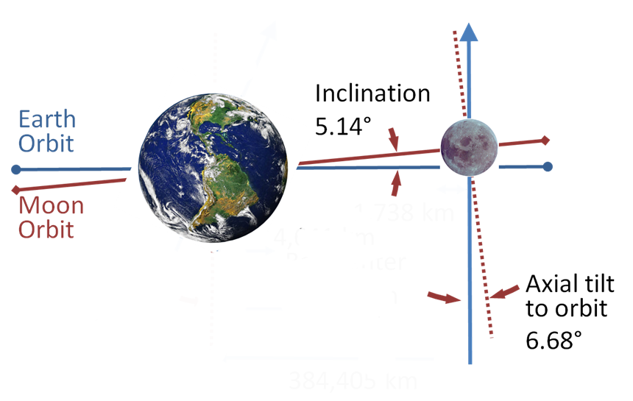
What is a Cassini State?
In 1643 Giovanni Cassini discovered spin-orbital coupling in the moon’s motion.
The following three vector always lie in one plane:
Vector normal to Earth’s orbit around the sun.
Vector normal to the orbit of the moon around Earth
Spin axis of the moon
The moon regresses with an 18.6 year period. The so-called Cassini state is an example of a
secular spin-orbit resonance.
Adopted from wikipedia

Slide 14
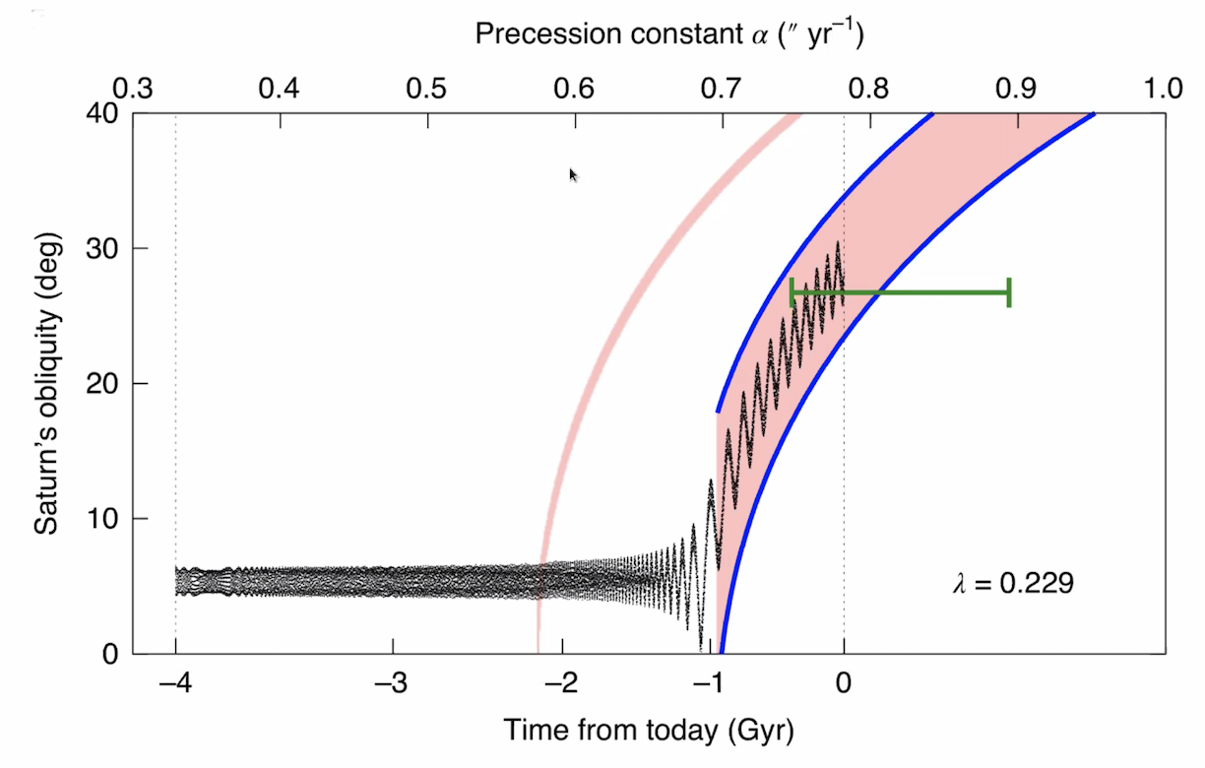
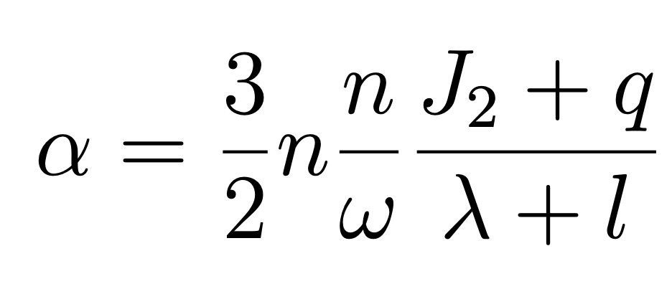
This Saturn in Resonance with Neptune?
This depends on Saturn’s Angular Momentum
Saillenfest (2021)
Torques acting on Saturn
Torques acting on moons’ orbits including Titan
Precession constant:
Saturn’s moment of inertia: C/MR²
Moons’ contribution to angular momentum

Slide 15
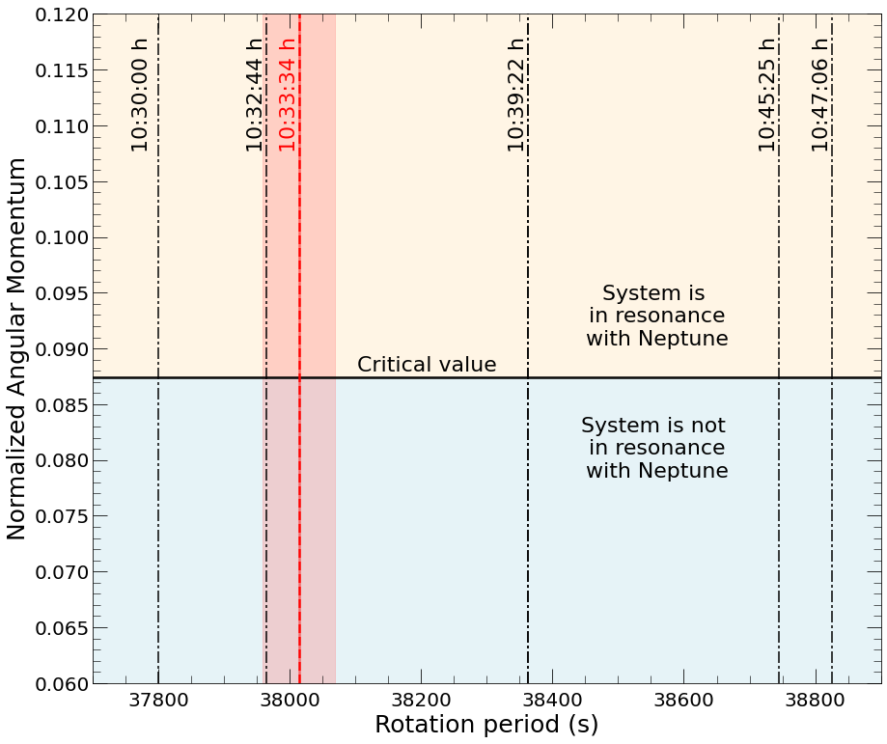
This Saturn in Resonance with Neptune?
This depends on Saturn’s Angular Momentum
Saillenfest (2021)
Precession constant:
Saturn’s moment of inertia: C/MR²
Moons’ contribution to angular momentum

Slide 16
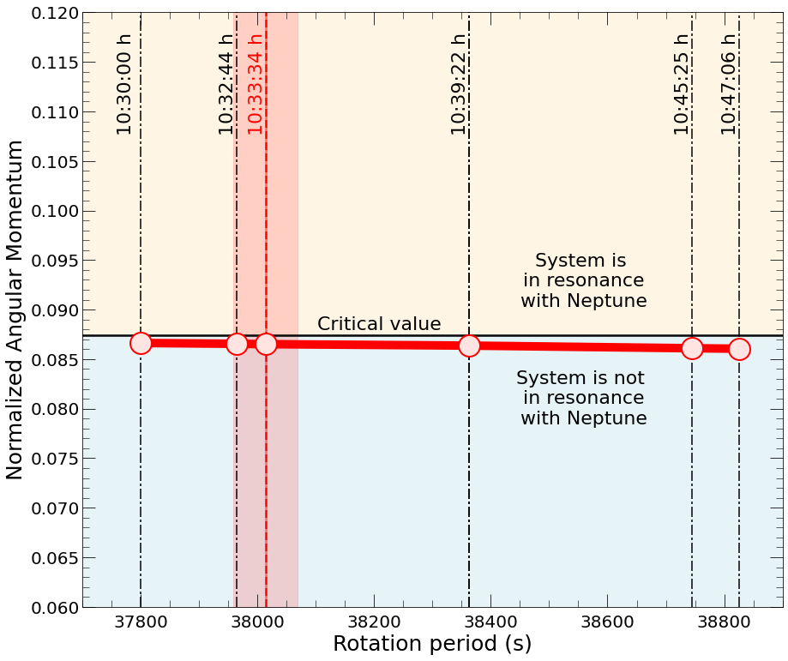
This Saturn in Resonance with Neptune?
This depends on Saturn’s Angular Momentum
Saillenfest (2021)
Precession constant:
Saturn’s moment of inertia: C/MR²
Moons’ contribution to angular momentum

Slide 17
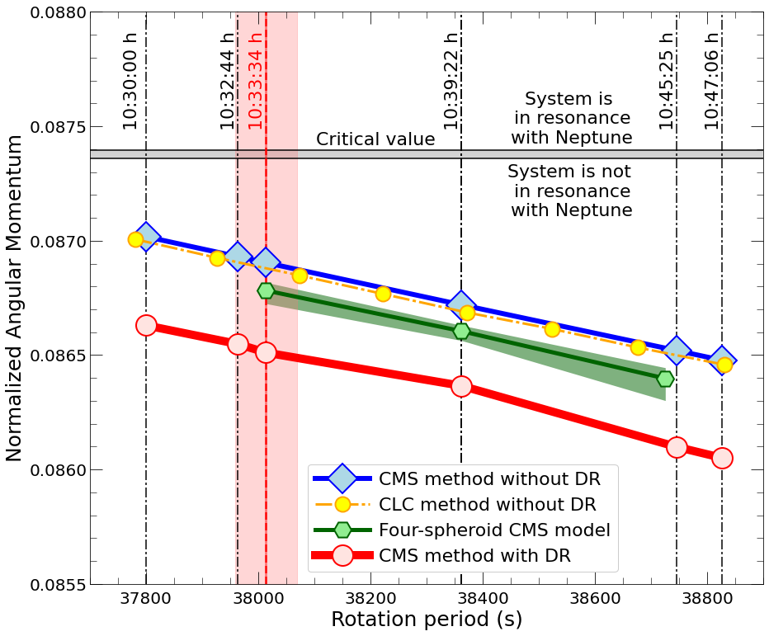
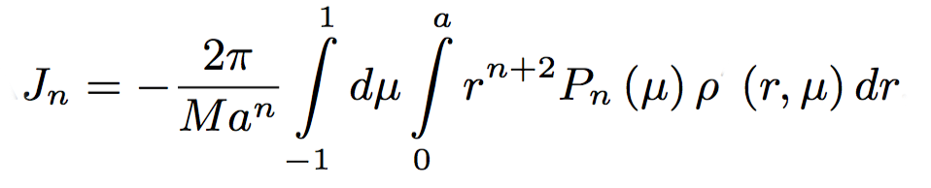
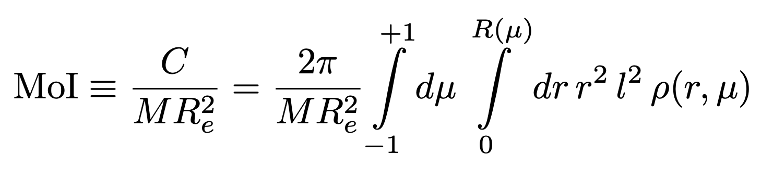
Why do J₂, J₄, and J₆ constrain the moment of inertia so well?

Slide 18
Our scenario for the formation of Saturn's rings
The Saturnian system formed with an additional moon, Chrysalis. Saturn's spin axis was perpendicular to its orbital plane.
Chrysalis gave Neptune an extra "handle" to tilt Saturn's spin axis (via a spin-orbit resonance) to the large value that we see today, 27º.
Saturn's moon Titan started to migrate out. About 160 million years ago, it entered into a resonance with the moon Chrysalis destabilizing its orbit.
As a result, Chrysalis came so close to Saturn that it was sheared apart by Saturn's intense gravity (tidal disruption). Most of the material fell into Saturn but out of 1%, the rings formed.
With Chrysalis gone, Neptune could no longer change Saturn's spin axis. So the planet was left spinning at an angle of 27º.

Slide 19
Our scenario for the formation of Saturn's rings is supported by the following lines of evidence:
It predicts a young age for Saturn's rings of only 100 million years approximately. This is in agreement with the ring color and Cassini's measurements of the ring mass.
It explains why Saturn's spin axis is tilted rather than being vertical, which it was when the planet formed.
It also explains why Saturn's moment of inertia is so close to the critical value to be in a spin-orbit resonance with Neptune but just outside of the critical region.
It is consistent with Titan's observed migration and offers an explanation why its orbit is slightly elliptical.

Slide 20
The End
Any Questions?

