Slide 1
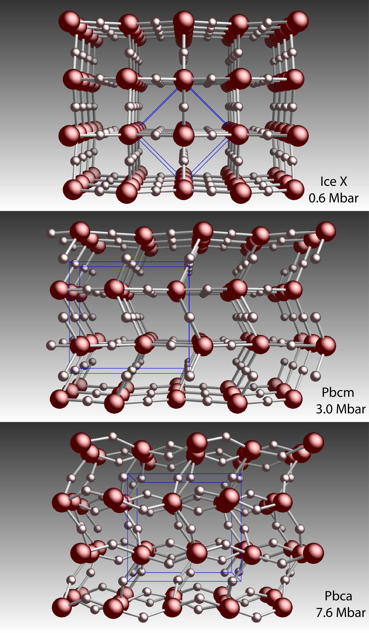
Ab Initio Structure Search Methods predict Seven New Ice Structures at High Pressure
Name/Symmetry | Author,Year | Pressure (Mbar) | #mol.
Ice X (Pn-3m) | Polian,1984 | 0.44 | 2
Pbcm | Benoit, 1996 | 3 | 4
Pbca | Militzer, Wilson, 2010 | 7.6 | 8
I-42d | Wang, 2011 | 8.1 | 8
P2₁ | McMahon,2011 | 11.7 | 4
 | Ji, 2011 | 11.4 | 4
 | Wang, 2011 | 14 | 4
 | Hermann, 2011 | 11.7 | 4
P2₁/c | Ji, 2011 | 19.6 | 8
C2/m (metallic) | McMahon, 2011 | 56.2 | 2
 | Hermann, 2011 | 60 | 2
P2₁/m | Zhang, Militzer, 2013 | 135 | 4
I4/mmm | Zhang, Militzer, 2013 | 330 | 2
Militzer, Wilson, Phys. Rev. Lett. 105, 195701 (2010).
Wang et al., Nature Commun., 2, 563 (2011).
McMahon, PRB 84, 220104(R) (2011).
Ji et al., PRB, 84, 220105(R) (2011).
Hermann et al., PNAS 109, 745 (2011).
Zhang, Wilson, Driver, Militzer, PRB 87, 02411 (2013).

