Slide 1
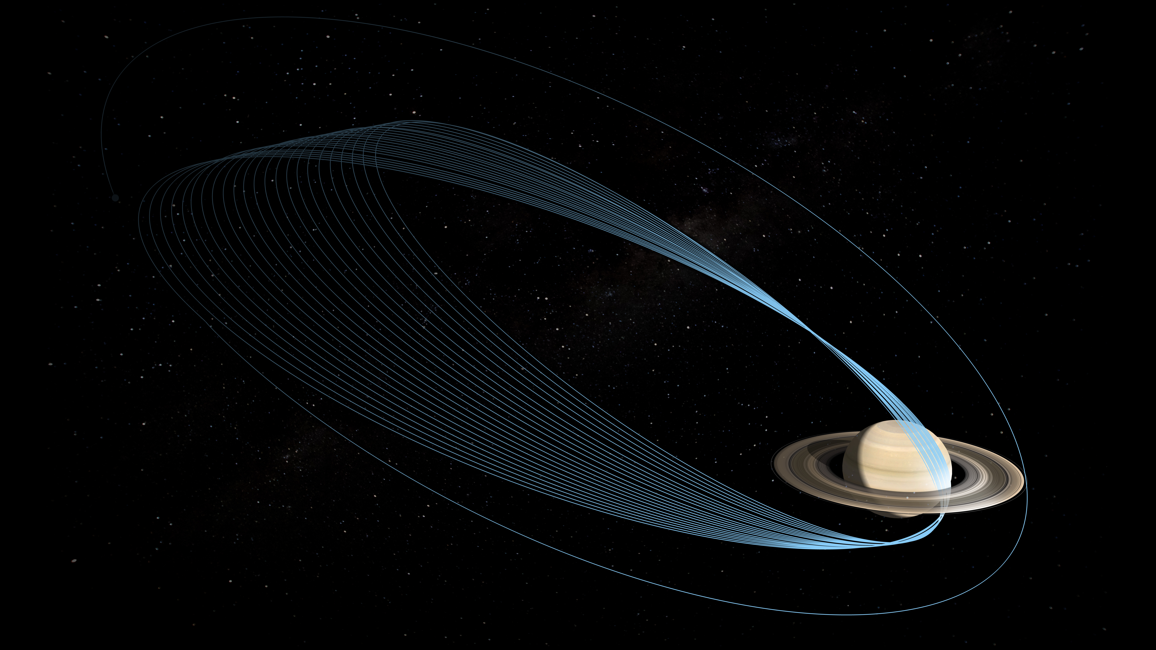
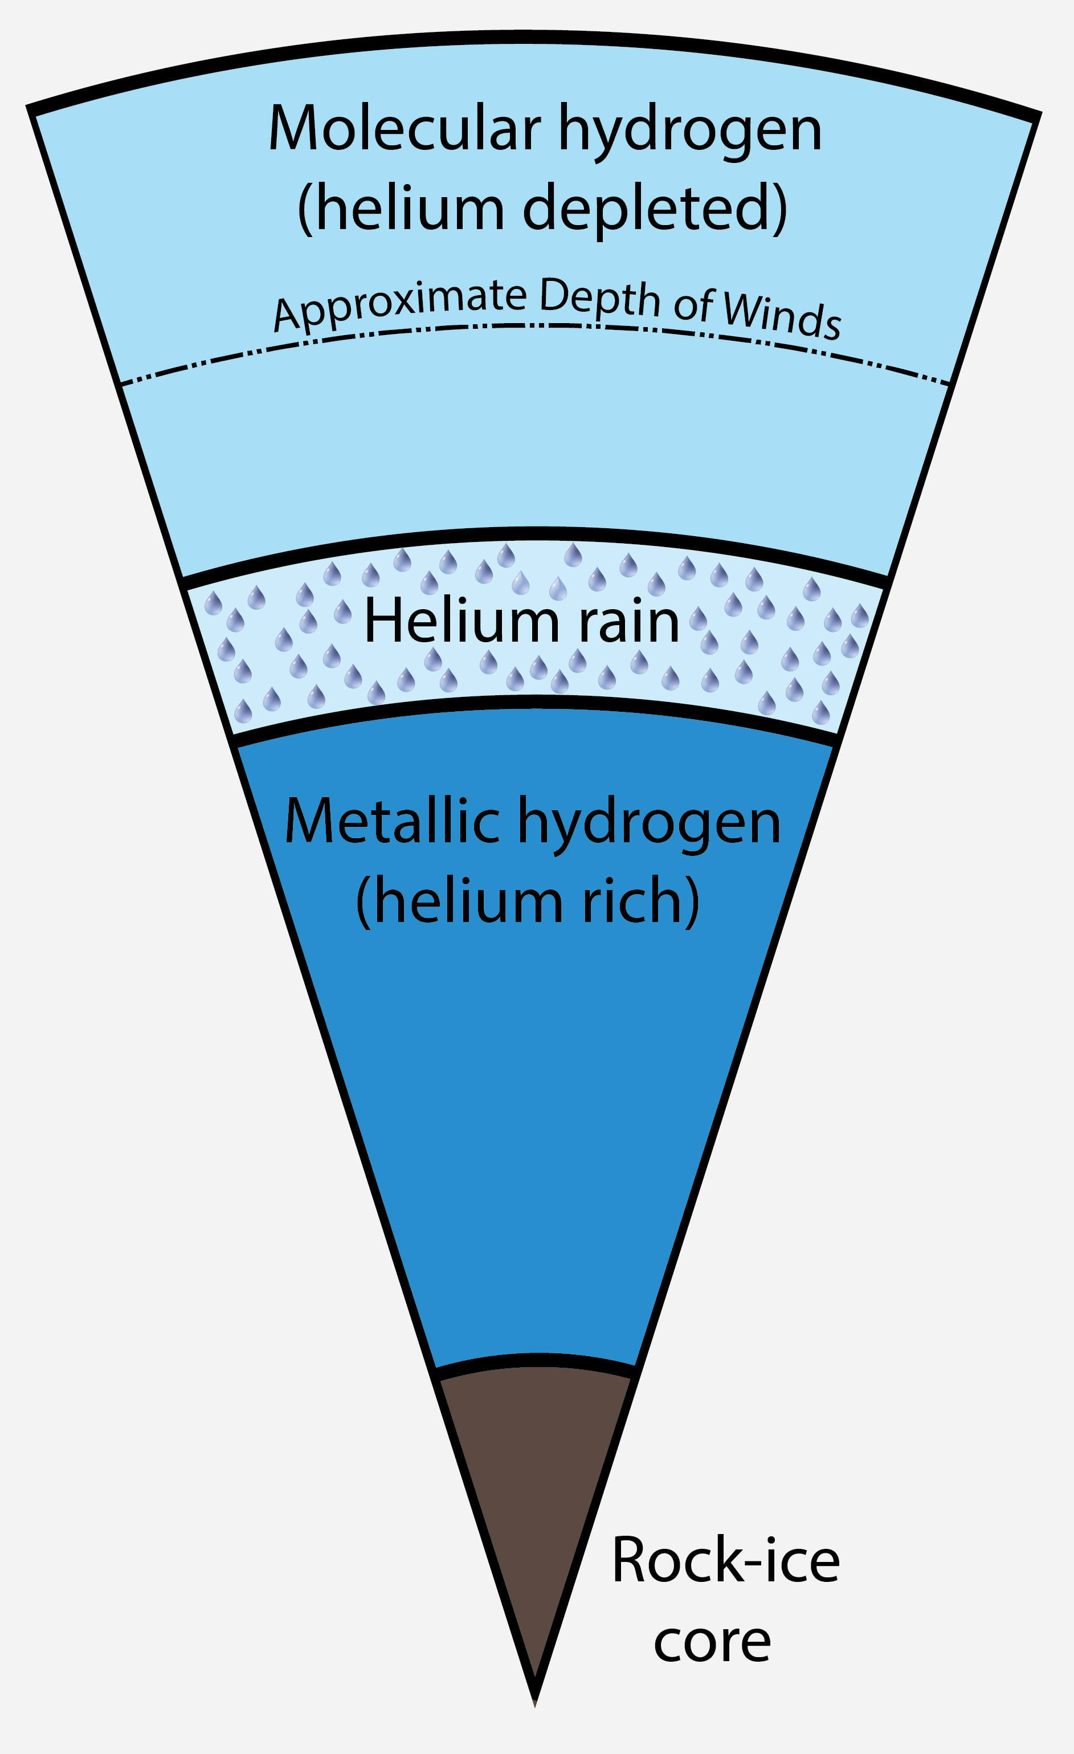
Measurement and Implications of Saturn’s Gravity Field and Ring Mass
Burkhard Militzer
Presentation prepared by
UC Berkeley
Authors of the article in Science: L. Iess, B. Militzer, Y. Kaspi, P. Nicholson, D. Durante, P. Racioppa, A. Anabtawi, E. Galanti, W. Hubbard, M. J. Mariani, P. Tortora, S. Wahl, M. Zannoni

Slide 2
1. Saturn’s Gravity Field

Slide 3
The Cassini Spacecraft Measured Saturn’s Gravity Field when it dove inside its rings before eventually burning up in its atmosphere

Slide 4
Saturn’s Gravity is highly unusual, cannot be matched with Uniform Rotation Models

Slide 5
Puzzling Cassini Gravity Data with unusually large J₆, J₈ and J₁₀
Models match mass, radius, and J₂ from Jacobson solution. All J_{2n} multiplied by 10⁶.
 | Range of Model Predictions assuming Uniform Rotation |  | Cassini Data Rev 273+274 solution | Unusual Model 1 (BM) | Unusual Model 2 (BM)
 | May 1, 2017 |  | May 19, 2017 | May 29, 2017
J₄ | -938.619 | -933.187 | -934.5792 | -934.5792 | -943.6830
J₆ | 80.532 | 81.737 | 86.5215 | 80.6008 | 82.2691
J₈ | -8.950 | -8.680 | -14.3704 | -8.6693 | -8.9477
J₁₀ | 1.076 | 1.129 | 4.9910 | 1.0721 | 1.1190
J₁₂ | -0.157 | -0.147 | -0.6670 | -0.1459 | -0.1540
J₁₄ | 0.0215 | 0.0234 | 0.5332 | 0.0213 | 0.0227
No model that assumed uniform rotation (no winds) could match the observations.

Slide 6
Effects of Differential Rotation

Slide 7
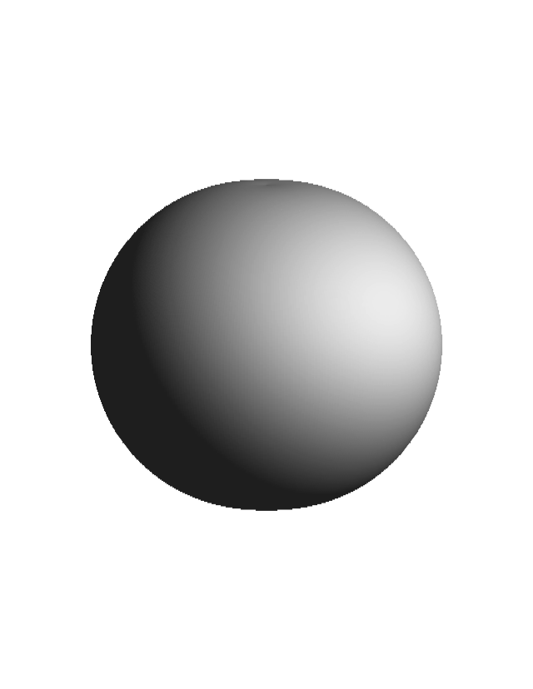
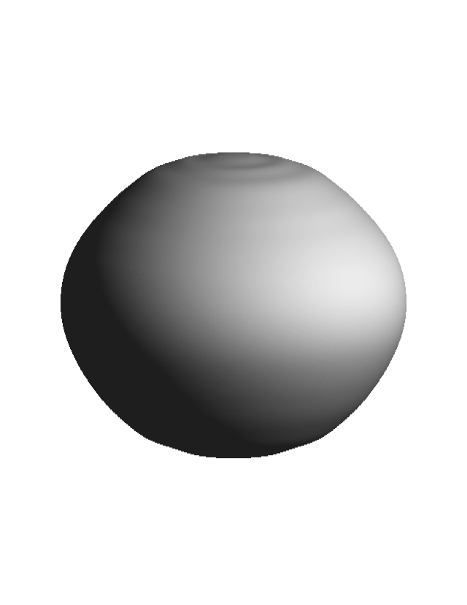
Effects of Differential Rotation
Rotational flattening from
uniform, solid-body rotation
Flattening from
differential rotation
(exaggerated).

Slide 8
Parameter Ranges in our Models that are consistent with the Spacecraft measurements
Saturn is predicted to have a rock-ice core worth 15-18 Earth masses.

Slide 9
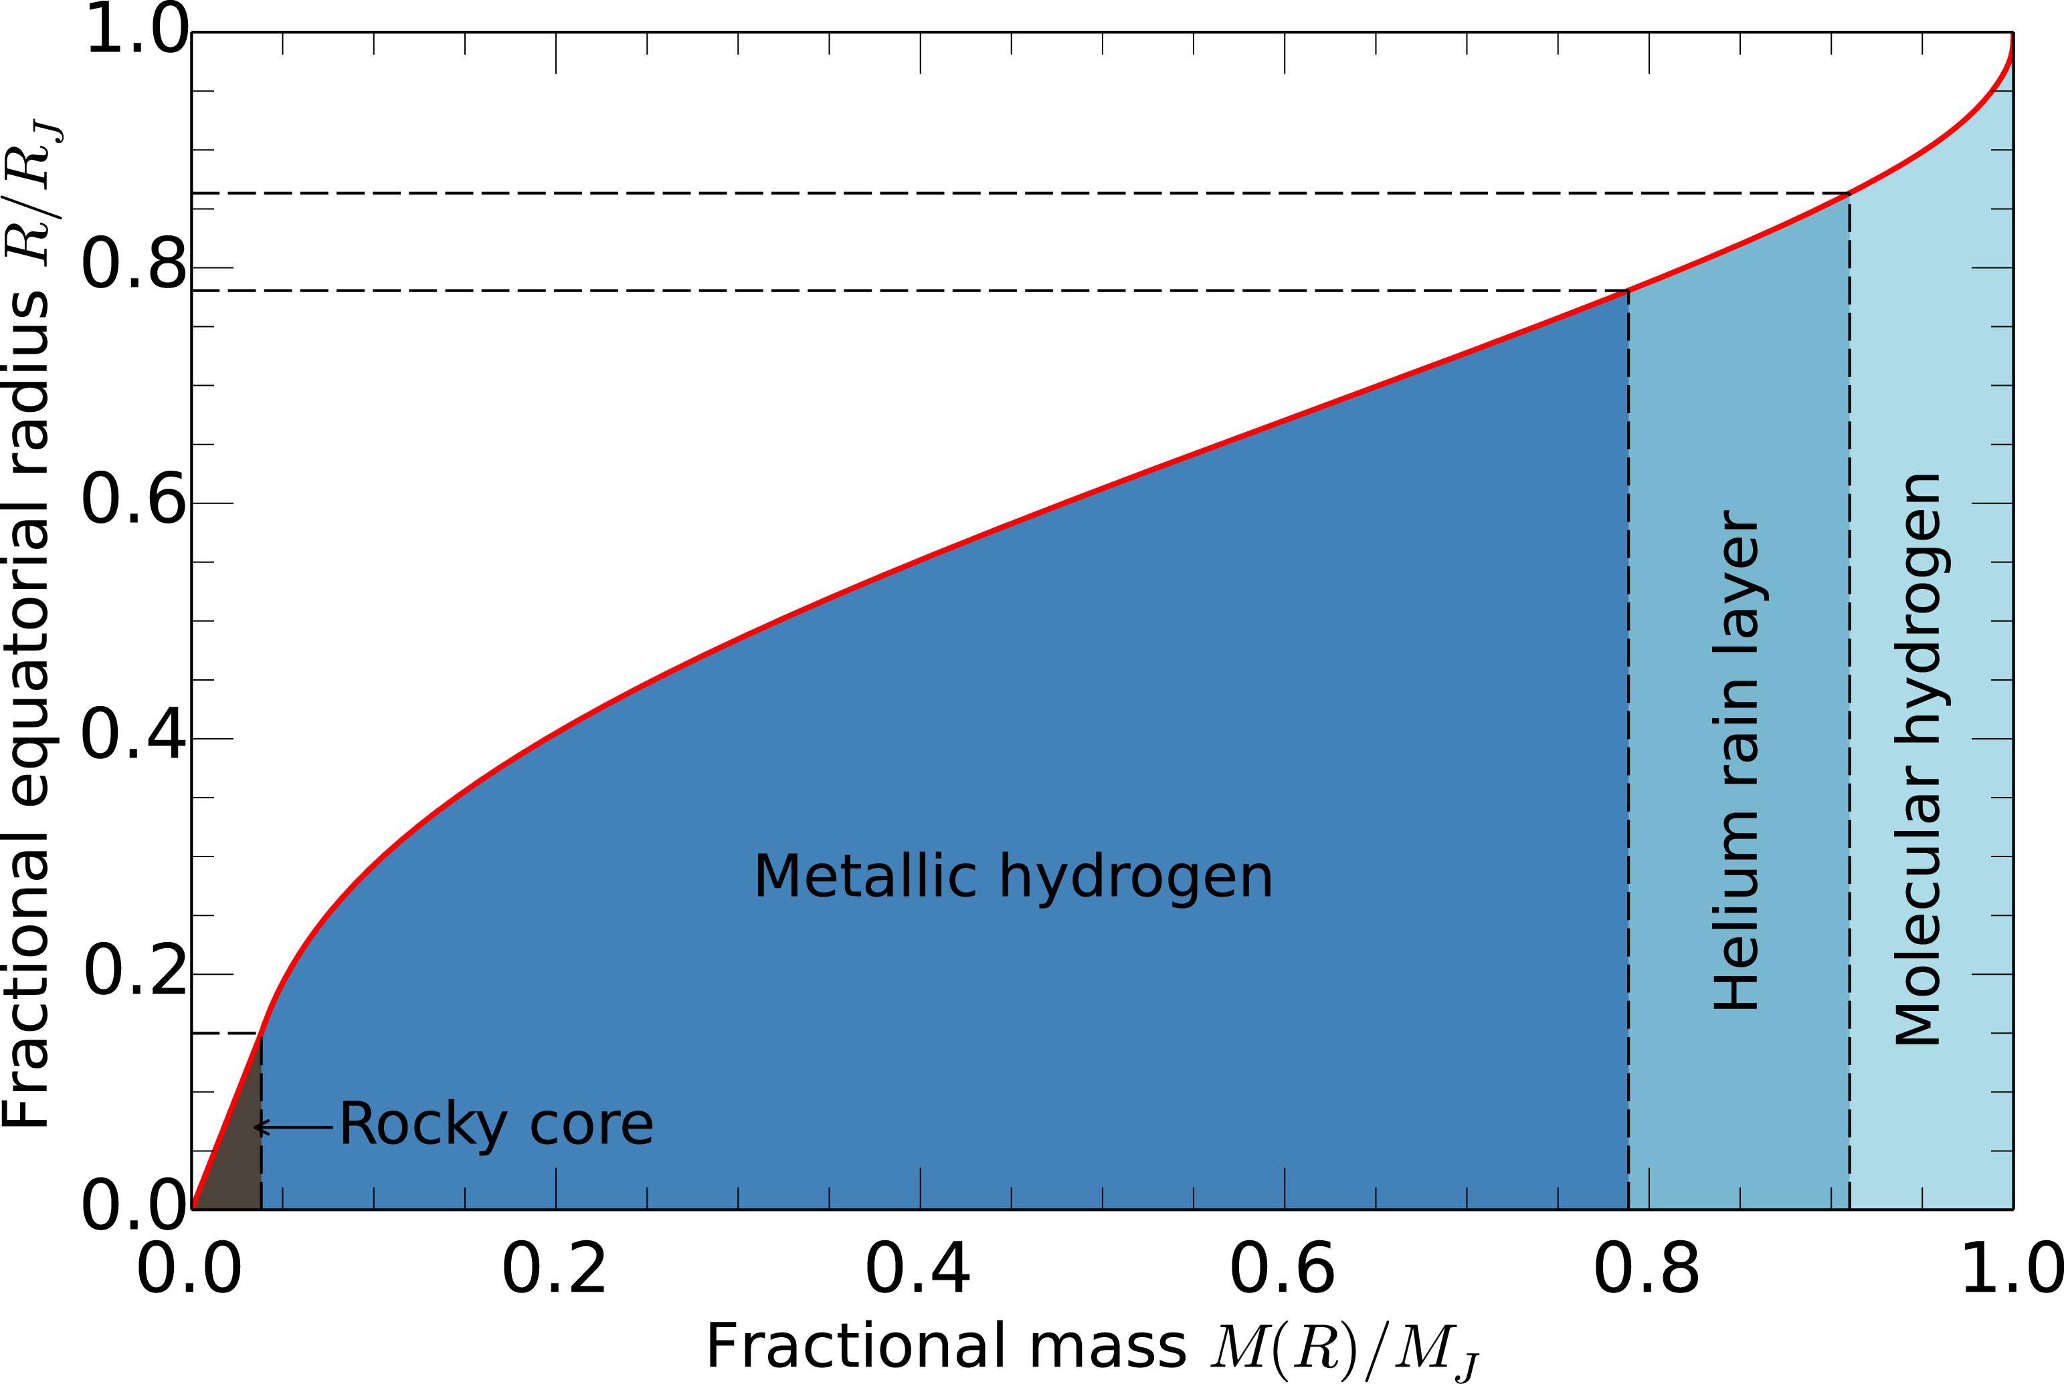
Typical for Giant Planet Interiors
Take Jupiter as an Example
Jupiter model
Militzer et al. (2016) JGR, 121.

Slide 10
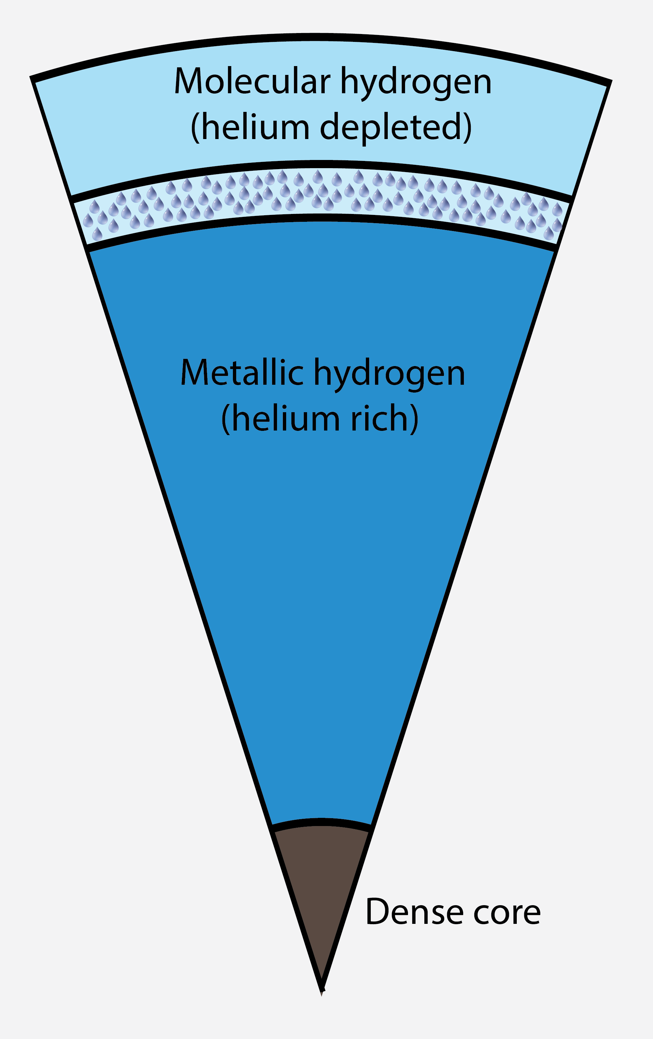
Comparison of Saturn and Jupiter
Saturn’s interior
Jupiter’s interior

Slide 11
2. Mass of Saturn’s Rings

Slide 12
How Do we Relate our Ring Mass Measurement to the Age of the Rings?
Assume rings started as pure water ice and have been steadily darkened by the infall of meteoroid material (Cuzzi, Estrada, 1998). The meteoroid flux (mass/year) is known. The color of the rings tell us about today’s rock-ice ratio. Our new mass measurements thus tell us when the rings formed and for how long meteoroids have polluted them.
Rate of recession of the small satellites from the rings due to gravitational torques (Borderies et al, 1984)
Evolution of unconfined edges such as the inner edges of the A and B rings (Estrada et al. 2015)
All these estimates depend on the total ring mass.

Slide 13
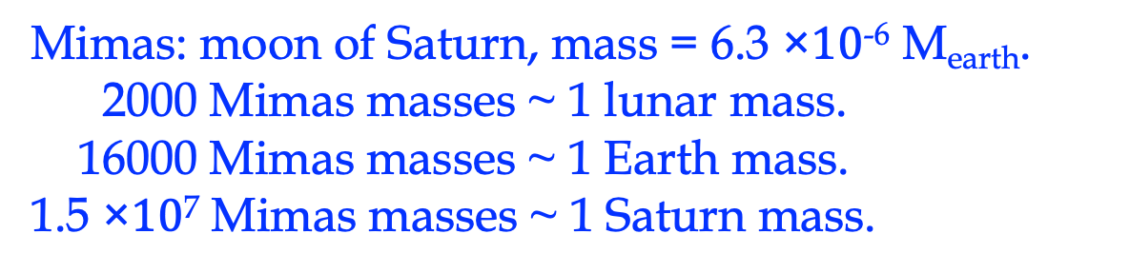
“Pre-Cassini” Ring Mass Estimate
The estimated total ring mass was
2.8 × 10¹⁹ kg or 0.75 Mimas masses
and became the standard pre-Cassini value.
However, it was argued that substantially more mass might be hidden in the opaque parts of the B ring.
Mimas: moon of Saturn, mass = 6.3 ×$10$⁻⁶ M_{earth}.
2000 Mimas masses ~ 1 lunar mass.
16000 Mimas masses ~ 1 Earth mass.
1.5 ×$10$⁷ Mimas masses ~ 1 Saturn mass.

Slide 14
Cassini observations of density waves
Cassini observations of density waves have led to local surface density estimates in the A, B and C rings.
The B ring density is surprisingly low, with a mean value of ~600 kg/m².
Likely total ring mass of 0.40 Mimas masses.
However, it is conceivable that some mass in the rings does not contribute to the density waves.

Slide 15
First Determination of
Saturn’s Ring Mass from Gravity
Directly from the gravity signal, we determined a total mass of the main rings A, B and C =
0.41+-0.13 Mimas masses.
Mass of diffuse D, F, G, and E rings assumed to be negligible.
An indication that the rings are young, were formed only 10-100 million years ago.

Slide 16
Possible Origin of Saturn’s Rings
The rings weigh 0.41 Mimas masses today but were much more massive earlier.
Rings possibly came about from the capture and following gravitational disruption of a comet or Centaur (Dones, 1991; Dones et al. 2007)
Alternatively they came from an earlier population of mid-sized icy satellites (Ćuk, ApJ, 2016). Their orbits became unstable and there was at least one giant collision that products the guzzilion of ring particles that we see today

Slide 17
Conclusions
Saturn is predicted to rotate differentially based on even gravity coefficient. The equatorial regions rotate about 4% faster than the deep interior.
Winds are at least 9000 km deep.
Saturn rings have a low mass and are young (10-100 million years). This points to a dramatic collision in our recent solar system history.

